Slide 1
Philippines
Last updated: September 2019

Slide 2
CONTENT
Basic socio-demographic indicators
HIV prevalence and epidemiological status
Risk behaviors
Vulnerability and HIV knowledge
HIV expenditure
National response

Slide 3
BASIC SOCIO-DEMOGRAPHIC INDICATORS
Total population (in thousands) | 100,699 (2015) ¹
Population aged 15-49 (thousands) | 53,037 (2015) ¹
Maternal mortality ratio (per 100 000 live births) | 114 (2015) ⁵
Percentage of population in urban areas | 44 (2015) ²
Antenatal care coverage - At least one visit (%) | 95.4 (2013) ⁷
Crude birth rate (births per 1,000 population) | 23.6 (2014) ²
Under-5 mortality rate (per 1,000 live births) | 28 (2015) ²
Human development index (HDI) - Rank/Value | 115/0.668 (2014) ⁴
Life expectancy at birth (years) - Male/Female | 65/72 (2015) ⁵
Adult literacy rate (%) | 95 (2008) ²
Ratio of girls to boys enrolled at primary level in public and private school (%) | 1.00 (2013) ²
GDP per capita (PPP, current international $) | 7,359 (2015) ²
Per capita total expenditure on health (PPP int. $) | 329 (2014) ³
Sources: Prepared by www.aidsdatahub.org based on 1. UN Population Division. (2015). World Population Prospects: The 2015 Revision - Extended Dataset; 2. World Bank. World Data Bank: World Development Indicators & Global Development Finance. Retrieved July 2016, from http://data.worldbank.org/; 3. WHO. Global Health Observatory Indicator Views: Per Capita Total Expenditure on Health (PPP int. $) (Health Systems), Retrieved July 2016, from http://apps.who.int/gho/data/node.imr.WHS7_105?lang=en; 4. Palanivel, T., Mirza, T., Tiwari, B. N., Standley, S., & Nigam, A. (2016). Asia-Pacific Human Development Report - Shaping the Future: How Changing Demographics Can Power Human Development; 5. WHO. (2016). World Health Statistics 2016: Monitoring health for the SDGs; 6. World Bank Group. (2016). World Development Indicators 2016 and 7. UNSD. Millennium Development Goals Database - Antenatal Care Coverage Retrieved May 2016, from http://data.un.org/Data.aspx?q=Antenatal+care+coverage&d=MDG&f=seriesRowID%3a762.

Slide 4
HIV prevalence and epidemiology

Slide 5
Estimated people living with HIV, new HIV infections and AIDS-related deaths, 1990-2018
13,000
1,200
Source: Prepared by www.aidsdatahub.org based on UNAIDS 2019 HIV Estimates

Slide 6
Estimated people living with HIV, new HIV infections and AIDS-related deaths, 1990-2018
Source: Prepared by www.aidsdatahub.org based on UNAIDS 2019 HIV Estimates

Slide 7
Estimated number of adults (15+) living with HIV and women (15+) living with HIV, 1990-2018
Source: Prepared by www.aidsdatahub.org based on UNAIDS 2019 HIV Estimates

Slide 8
Key population size estimates, 2015
Key population size estimates
Populations | Estimate | Year of estimate
People who inject drugs (PWID) | 10 000 | 2015
Female sex workers (FSW) | 66 000 | 2015
Men who have sex with men (MSM) | 531 500 | 2015
Male sex workers (MSW) | 86 600 | 2015
Transgender people (TG) | 122 800 | 2015
Source: Prepared by www.aidsdatahub.org based on Global AIDS Monitoring 2018

Slide 9
HIV prevalence among key populations, 2007-2015
Source: Prepared by www.aidsdatahub.org based on Integrated HIV Behavioral and Serologic Surveillance (IHBSS) 2007-2015; www.aidsinfoonline.org

Slide 10
HIV prevalence among key populations, 2015
TRANSGENDER PEOPLE
(2015)
MEN WHO HAVE SEX
WITH MEN (2015)
PEOPLE WHO
INJECT DRUGS (2015)
FEMALE
SEX WORKERS (2015)
Source: Prepared by www.aidsdatahub.org based on Serological surveys and Global AIDS Monitoring 2017

Slide 11
HIV prevalence among key populations, 2015
Source: Prepared by www.aidsdatahub.org based on www.aidsinfoonline.org

Slide 12
HIV prevalence among key populations by age group, 2015
Source: Prepared by www.aidsdatahub.org based on www.aidsinfoonline.org

Slide 13
High HIV prevalence among key populations in selected cities, 2015
M/TSM = Males or transgenders who have sex with males
Source: Prepared by www.aidsdatahub.org based on National HIV and STI Surveillance and Strategic Information Unit, Epidemiology Bureau, DOH. (2016). 2015 Integrated HIV Behavioral and Serologic Surveillance (IHBSS) Fact Sheets

Slide 14
HIV prevalence among males who have sex with males in selected cities, 2007-2015
* Data from the 2015 IHBSS is for a mixed survey sample of males or transgenders who have sex with males (M/TSM). In addition it has been adjusted using Time Location Sampling (TLS) weights, therefore it is not directly comparable to previous IHBSS rounds.
Source: Prepared by www.aidsdatahub.org based on Integrated HIV Behavioral and Serologic Surveillance (IHBSS) Reports

Slide 15
HIV prevalence among males who have sex with males by age group, 2009-2015
Source: Prepared by www.aidsdatahub.org based on National HIV/AIDS & STI Surveillance and Strategic Information Unit. Epidemiology Bureau, Department of Health. (2016). The growing HIV epidemic among adolescents in the Philippines.

Slide 16
HIV prevalence among FSW by age group, 2011 and 2013
Source: Prepared by www.aidsdatahub.org based on National HIV and STI Surveillance and Strategic Information Unit, National Epidemiology Center, DOH. (2014). 2013 Integrated HIV Behavioral and Serologic Surveillance (IHBSS) Report. Manila, Philippines.

Slide 17
HIV prevalence among male PWID by age group, Cebu City and Mandaue City, 2011 and 2013
Source: Prepared by www.aidsdatahub.org based on National HIV and STI Surveillance and Strategic Information Unit, National Epidemiology Center, DOH. (2013). 2013 IHBBS Briefer. Males who have Sex with Males (MSM) and Male Injecting Drug Users (IDU) - Preliminary report. Manila, Philippines.

Slide 18
HIV prevalence among PWID in selected geographical locations, 2005-2013
Source: Prepared by www.aidsdatahub.org based on Philippines Integrated HIV Behavioral and Serologic Surveillance Reports 2005 to 2013

Slide 19
Syphilis prevalence among key populations in selected cities, 2015
Source: Prepared by www.aidsdatahub.org based on National HIV and STI Surveillance and Strategic Information Unit, Epidemiology Bureau, DOH. (2016). 2015 Integrated HIV Behavioral and Serologic Surveillance (IHBSS) Fact Sheets

Slide 20
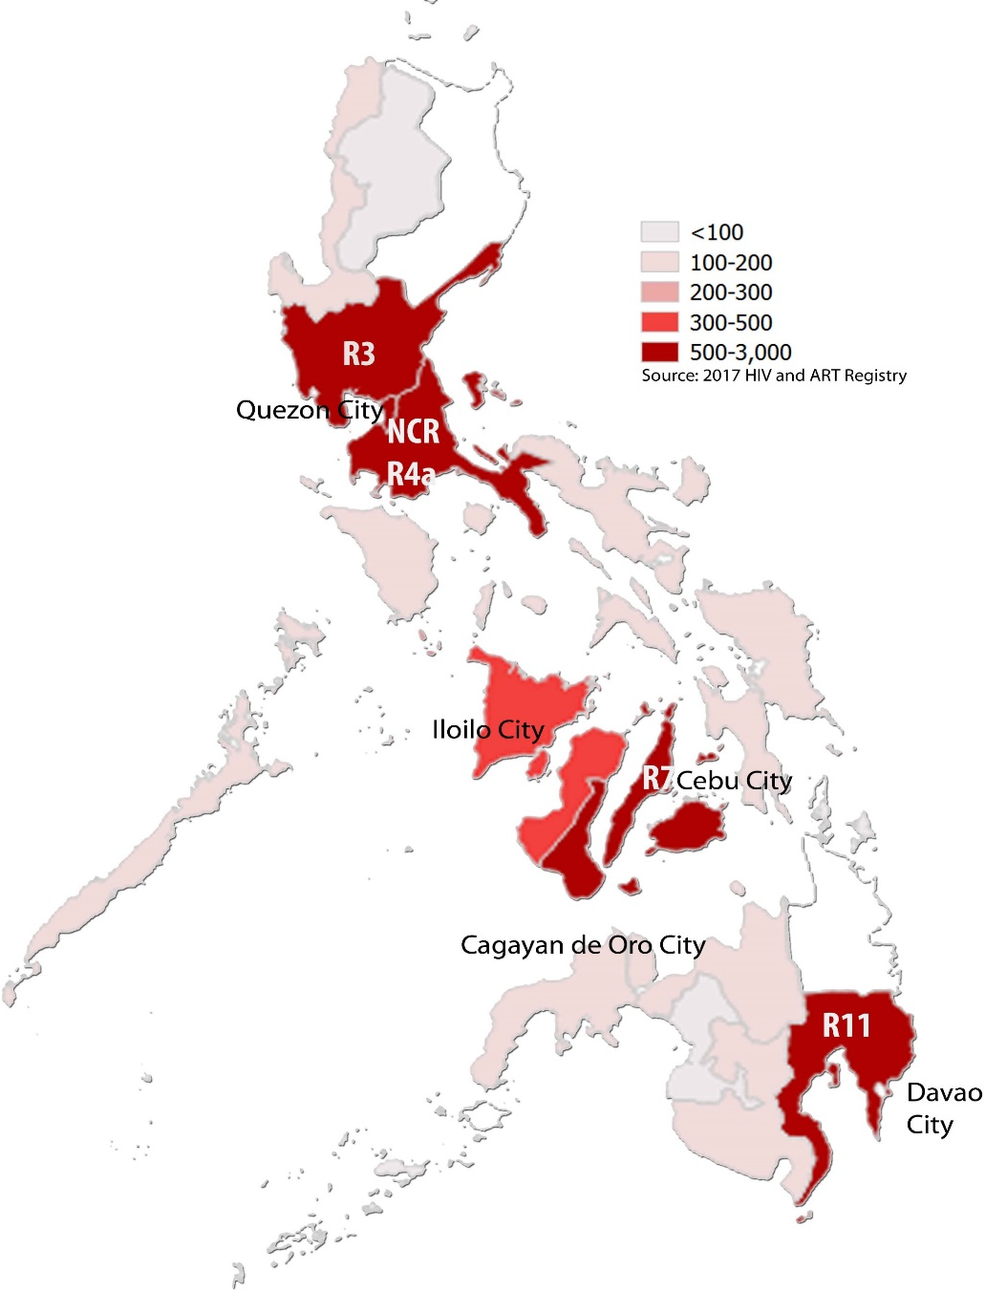
Geographical distribution of reported HIV cases in Philippines, 2017
Source: National Epidemiology Center Philippines. (2018). Philippines HIV/AIDS Registry 2017

Slide 21
Annual number of reported HIV cases, AIDS cases, and AIDS related deaths, 1984 – May 2016
Source: Prepared by www.aidsdatahub.org based on National Epidemiology Center Philippines. Philippines HIV/AIDS Registry Reports

Slide 22
Reported HIV cases by mode of transmission, 1984-May 2016
Source: Prepared by www.aidsdatahub.org based on National Epidemiology Center Philippines. Philippines HIV /AIDS Registries, 2008 – May 2016

Slide 23
Cumulative HIV cases by mode of transmission, January 1984-May 2016
Source: Prepared by www.aidsdatahub.org based on National Epidemiology Center Philippines. (2016). Philippines HIV/AIDS Registry: May 2016

Slide 24
Cumulative HIV cases by mode of transmission among children and adolescents, January 1984 – May 2016
Note: Mode of transmission was not reported for 9 out of 1,187 cases
Source: Prepared by www.aidsdatahub.org based on National Epidemiology Center Philippines. (2016). Philippines HIV/AIDS Registry: May 2016

Slide 25
Proportion of HIV cases among Overseas Filipino workers (OFWs) compared to Non-OFWs, 2000- May 2016
Source: Prepared by www.aidsdatahub.org based on National Epidemiology Center Philippines. (2016). Philippines HIV/AIDS Registry: May 2016

Slide 26
Risk behaviours

Slide 27
Proportion of key populations who reported condom use at last sex, 2007-2015
Source: Prepared by www.aidsdatahub.org based on 1. UNAIDS Report on The Global AIDS Epidemic, 2010; and 2. www.aidsinfoonline.org

Slide 28
Proportion of FSW who reported condom use with their most recent client, by city, 2013
Source: Prepared by www.aidsdatahub.org based on National HIV and STI Surveillance and Strategic Information Unit, National Epidemiology Center, DOH. (2014). 2013 Integrated HIV Behavioral and Serologic Surveillance (IHBSS) Report. Manila, Philippines.

Slide 29
Proportion of FSW who reported condom at last sex, by partner type and by city, 2015
Source: Prepared by www.aidsdatahub.org based on National HIV and STI Surveillance and Strategic Information Unit, Epidemiology Bureau, DOH. (2016). 2015 Integrated HIV Behavioral and Serologic Surveillance (IHBSS) Fact Sheets.

Slide 30
Proportion of males who have sex with males who reported condom use at last sex with male partner, selected cities, 2015
Source: Prepared by www.aidsdatahub.org based on National HIV and STI Surveillance and Strategic Information Unit, Epidemiology Bureau, DOH. (2016). 2015 Integrated HIV Behavioral and Serologic Surveillance (IHBSS) Fact Sheets.

Slide 31
Proportion of MSM who reported condom use at last sex with a male partner in the last 12 months, by age group and city, 2014
Source: Prepared by www.aidsdatahub.org based on Special MSM IHBSS 2014 as part of Big Cities Project (BCP) reported in National HIV and STI Surveillance and Strategic Information Unit, National Epidemiology Center, DOH. (2014). 2013 IHBSS Report. Manila, Philippines.

Slide 32
Proportion of PWID who reported condom use at last sex by partner type and city, 2015
Source: Prepared by www.aidsdatahub.org based on National HIV and STI Surveillance and Strategic Information Unit, Epidemiology Bureau, DOH. (2016). 2015 Integrated HIV Behavioral and Serologic Surveillance (IHBSS) Fact Sheets.

Slide 33
Proportion of male entertainment establishment workers who reported condom use at last sex by partner type and by city, 2015
Source: Prepared by www.aidsdatahub.org based on National HIV and STI Surveillance and Strategic Information Unit, Epidemiology Bureau, DOH. (2016). 2015 Integrated HIV Behavioral and Serologic Surveillance (IHBSS) Fact Sheets.

Slide 34
Proportion of transgender women who reported condom with their most recent client by city and by age-group, 2015
Source: Prepared by www.aidsdatahub.org based on National HIV and STI Surveillance and Strategic Information Unit, Epidemiology Bureau, DOH. (2016). 2015 Integrated HIV Behavioral and Serologic Surveillance (IHBSS) Fact Sheets.

Slide 35
Proportion of PWID who reported using sterile injecting equipment at the last time that they injected, 2007-2015
Source: Prepared by www.aidsdatahub.org based on 1) UNAIDS Report on The Global AIDS Epidemic, 2010; and 2) www.aidsinfoonline.org

Slide 36
Proportion of key populations with reported drug use behaviors in the last 12 months, 2013
Source: Prepared by www.aidsdatahub.org based on 1) National HIV and STI Surveillance and Strategic Information Unit, National Epidemiology Center, DOH. (2014). 2013 Integrated HIV Behavioral and Serologic Surveillance (IHBSS) Report. Manila, Philippines; and 2) National HIV and STI Surveillance and Strategic Information Unit, Epidemiology Bureau, DOH. (2016). 2015 Integrated HIV Behavioral and Serologic Surveillance (IHBSS) Fact Sheets.

Slide 37
Proportion of males who have sex with males who engaged in transactional sex in the last year, selected cities, 2015
Note: Survey included males or transgenders who have sex with males
Source: Prepared by www.aidsdatahub.org based on National HIV and STI Surveillance and Strategic Information Unit, Epidemiology Bureau, DOH. (2016). 2015 Integrated HIV Behavioral and Serologic Surveillance (IHBSS) Fact Sheets.

Slide 38
Sexual behavior and condom use among MSM in the last 12 months, 2011 and 2013
Source: Prepared by www.aidsdatahub.org based on National Epidemiology Center Philippines. Integrated HIV Behavioural and Serologic Surveillance Reports for 2011 and 2013

Slide 39
Median number of sexual partners reported among surveyed key populations, 2015
Source: Prepared by www.aidsdatahub.org based on National HIV and STI Surveillance and Strategic Information Unit, Epidemiology Bureau, DOH. (2016). 2015 Integrated HIV Behavioral and Serologic Surveillance (IHBSS) Fact Sheets.

Slide 40
Proportion of young women (15-24) who had premarital sex in the past 12 months, and used condom at last sex by age group and residence, 2013
Source: Prepared by www.aidsdatahub.org based on Philippine Statistics Authority (PSA) [Philippines], and ICF International. (2014). Philippines National Demographic and Health Survey 2013. Manila, Philippines, and Rockville, Maryland, USA: PSA and ICF International.

Slide 41
Vulnerability and HIV knowledge

Slide 42
Proportion of key populations with comprehensive HIV knowledge, 2011-2015
Source: Prepared by www.aidsdatahub.org based on Integrated HIV Behavioral and Serologic Surveillance (IHBSS) Reports

Slide 43
Proportion of key populations with comprehensive knowledge of HIV by age group, 2013
Source: Prepared by www.aidsdatahub.org based on National HIV and STI Surveillance and Strategic Information Unit, National Epidemiology Center, DOH. (2014). 2013 Integrated HIV Behavioral and Serologic Surveillance (IHBSS) Report. Manila, Philippines.

Slide 44
Proportion of key populations with comprehensive HIV knowledge, selected cities, 2015
Source: Prepared by www.aidsdatahub.org based on National HIV and STI Surveillance and Strategic Information Unit, Epidemiology Bureau, DOH. (2016). 2015 Integrated HIV Behavioral and Serologic Surveillance (IHBSS) Fact Sheets.

Slide 45
HIV expenditure

Slide 46
AIDS Spending by financing source, 2005-2017
Source: Prepared by www.aidsdatahub.org based on www.aidsinfoonline.org and NASA 2015 and 2017

Slide 47
AIDS Spending by financing source, 2005-2013
Source: Prepared by www.aidsdatahub.org based on www.aidsinfoonline.org

Slide 48
AIDS spending by category, 2005-2013
Source: Prepared by www.aidsdatahub.org based on www.aidsinfoonline.org

Slide 49
Proportion of total prevention programme spending on key populations at higher risk, 2005-2013
Source: Prepared by www.aidsdatahub.org based on www.aidsinfoonline.org

Slide 50
Proportion of spending on HIV prevention programmes from domestic and international sources, 2005 - 2013
Source: Prepared by www.aidsdatahub.org based on www.aidsinfoonline.org

Slide 51
Proportion of spending on care and treatment from domestic and international sources, 2005 - 2013
Source: Prepared by www.aidsdatahub.org based on www.aidsinfoonline.org

Slide 52
National response

Slide 53
Proportion of key populations reached with HIV prevention programmes, 2007-2013
Source: Prepared by www.aidsdatahub.org based on 1. National Epidemiology Center Philippines: Integrated HIV Behavioral and Serologic Surveillance (IHBSS) 2007, 2009, 2011 and 2013; 2. UNAIDS. (2012). Annexes - UNAIDS Report on the Global AIDS Epidemic 2012; and 3. www.aidsinfoonline.org

Slide 54
Number of needle/syringes distributed per person who inject drugs per year
Source: Prepared by www.aidsdatahub.org based on 1. WHO, UNAIDS, & UNICEF. (2009). Towards Universal Access: Scaling up Priority HIV/AIDS Interventions in the Health Sector- Progress Report 2009; 2. WHO, UNAIDS, & UNICEF. (2010). Towards Universal Access: Scaling up Priority HIV/AIDS Interventions in the Health Sector - Progress Report 2010

Slide 55
Proportion of key populations who received an HIV test in the last 12 months and knew their results, 2007-2015
Source: Prepared by www.aidsdatahub.org based on 1) UNAIDS Report on the Global AIDS Epidemic, 2010; and 2) www.aidsinfoonline.org

Slide 56
Proportion of key populations who received an HIV test in the last 12 months, selected cities, 2015
Source: Prepared by www.aidsdatahub.org based on National HIV and STI Surveillance and Strategic Information Unit, Epidemiology Bureau, DOH. (2016). 2015 Integrated HIV Behavioral and Serologic Surveillance (IHBSS) Fact Sheets.

Slide 57
Proportion of key populations who know where to get tested for HIV, selected cities, 2015
Source: Prepared by www.aidsdatahub.org based on National HIV and STI Surveillance and Strategic Information Unit, Epidemiology Bureau, DOH. (2016). 2015 Integrated HIV Behavioral and Serologic Surveillance (IHBSS) Fact Sheets.

Slide 58
HIV testing and treatment cascade, 2018
Source: Prepared by www.aidsdatahub.org based on UNAIDS. (2019). UNAIDS 2019 HIV Estimates and Global AIDS Monitoring 2019

Slide 59
Treatment cascade, 2018
Source: Prepared by www.aidsdatahub.org based on UNAIDS. (2019). UNAIDS 2019 HIV Estimates and Global AIDS Monitoring 2019

Slide 60
Estimated adults living with HIV, adults receiving ARVs, and adult ART coverage, 2018
Source: Prepared by www.aidsdatahub.org based on UNAIDS. (2019). UNAIDS 2019 HIV Estimates and Global AIDS Monitoring 2019

Slide 61
ART scale up, 2000-2018
Source: Prepared by www.aidsdatahub.org based on UNAIDS. (2019). UNAIDS 2019 HIV Estimates and Global AIDS Monitoring 2019

Slide 62
Estimated pregnant women living with HIV, pregnant women receiving ARVs, and PMTCT coverage, 2018
Source: Prepared by www.aidsdatahub.org based on UNAIDS. (2019). UNAIDS 2019 HIV Estimates and Global AIDS Monitoring 2019

Slide 63
National data on stigma and discrimination
Selected indicators of response from NCPI 2014
Access to justice:
Legal services (legal aid or other) NHRI or other mechanisms
Civil society perspectives/ratings: | 2009 | 2011 | 2013 | Trend
Laws and policies in place to protect and promote HIV-related human rights | 2/10 | 3/10 | 2/10
Efforts to implement human rights-related laws and policies | 2/10 | 3/10 | 2/10
STIGMA INDEX (2009-10 Data)
Percent of PLHIV respondents who avoided going to a local clinic when needed because of HIV status: 20%
Source: Prepared by UNAIDS Regional Support Team Asia and the Pacific andwww.aidsdatahub.org based on information provided by UNAIDS country office and partners

Slide 64
THANK YOU
slides compiled by www.aidsdatahub.org
Data shown in this slide set are comprehensive to the extent they are available from country reports. Please inform us if you know of sources where more recent data can be used.
Please acknowledge www.aidsdatahub.org if slides are lifted directly from this site.

