Slide 1
China
Last Updated: November 2019

Slide 2
CONTENT
Basic socio-demographic indicators
HIV prevalence and epidemiological status
Risk behaviors
Vulnerability and HIV knowledge
HIV expenditure
National response

Slide 3
BASIC SOCIO-DEMOGRAPHIC INDICATORS
Total population (in thousands) | 1,393,784 (2014) ⁴
Annual population growth rate | 0.6 (2014) ⁴
Population aged 15-49 (thousands) | 766,799 (2014) ⁴
Percentage of population in urban areas | 53 (2013) ³
Crude birth rate (births per 1,000 population) | 12.1 (2012) ³
Under-5 mortality rate (per 1,000 live births) | 14 (2012) ²
Human development index (HDI) - Rank/Value | 91/0.719 (2013) ¹
Life expectancy at birth (years) | 75.3 (2013) ¹
Adult literacy rate (%) | 95.1 (2005-2012) ¹
Ratio of girls to boys in primary and secondary education (%) | 100.8 (2012) ³
GDP per capita (PPP, $US) | 6,807 (2013) ³
Per capita total health expenditure (Int.$) | 423 (2011) ²
Sources: Prepared by www.aidsdatahub.org based on 1. UNDP. (2014). Human Development Report 2014 Sustaining Human Progress: Reducing Vulnerabilities and Building Resilience; 2. WHO. (2014). World Health Statistics 2014; 3. World Bank. World Data Bank: World Development Indicators & Global Development Finance. Retrieved October, 2014, from h​t​t​p​:​/​/​d​a​t​a​b​a​n​k​.​w​o​r​l​d​b​a​n​k​.​o​r​g​​; and 4. UN Population Division. (2013). World Population Prospects: The 2012 Revision - Extended Dataset.

Slide 4
HIV prevalence and epidemiology

Slide 5
Estimated number of people living with HIV, new HIV infections and AIDS-related deaths, 2018
 | Estimates | Year of estimates
People living with HIV (15+ yr) | 1.25 million (1.04 - 1.46million) | 2018
New HIV infections (15+ yr) | 81,000 (60,000 - 105,000) | 2018
AIDS-related deaths (15+ yr) | 35,000（23,000 - 48,000) | 2018
Source: Prepared by www.aidsdatahub.org based on NCAIDS, China CDC

Slide 6
Key population size estimates, 2011
Population size estimates
Populations | Estimate | Year of estimate
People who inject drugs | 2.17 million | 2011
Female sex workers | 2.47 million | 2011
Men who have sex with men | 3.83 million | 2011
Source: Prepared by www.aidsdatahub.org based on Ministry of Health China, WHO, and UNAIDS. (2011). 2011 Estimates for the HIV/AIDS Epidemic in China (Unpublished).

Slide 7
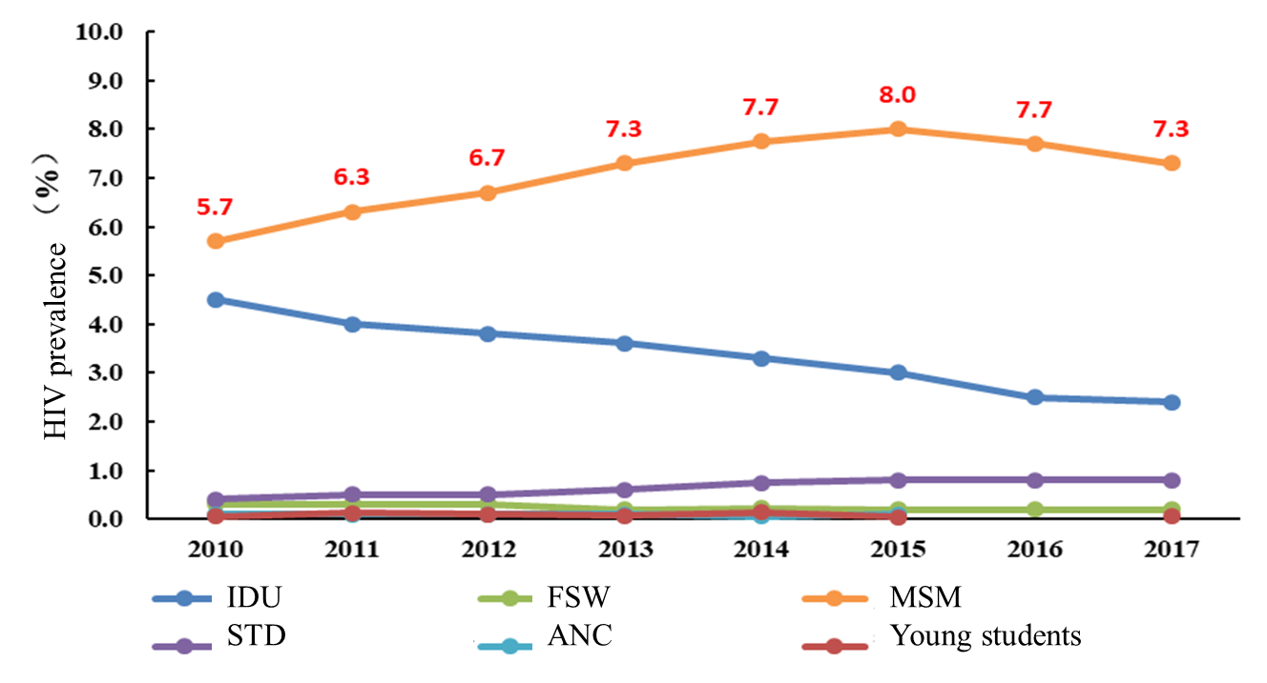
Trends of HIV prevalence by sentinel population, 2010-2017
Source: NCAIDS, China CDC

Slide 8
HIV prevalence among key populations, 2014
Source: Prepared by www.aidsdatahub.org based on www.aidsinfoonline.org

Slide 9
HIV prevalence among key populations, 2003-2014
Sources: Prepared by www.aidsdatahub.org based on 1. Office of the State Council Working Committee on AIDS China. (2005). Progress on Implementing UNGASS Declaration of Commitment in China 2005; 2. State Council AIDS Working Committee Office China. (2008). UNGASS Country Progress Report: China; 3. State Council AIDS Working Committee Office China. (2010). UNGASS Country Progress Report: China, 4. State Council AIDS Working Committee Office China. (2012). China Global AIDS Response Progress Report, 2012; 5. National Sentinel Surveillance, 2013; 6. National Health and Family Planning Commission of The People’s Republic of China. (2014). 2014 China AIDS Response Progress Report (unpublished), and 7. www.aidsinfoonline.org

Slide 10
HIV prevalence among key populations in selected cities/provinces
Source: Prepared by www.aidsdatahub.org based on 1. Chengdu Center for Disease Control and Prevention. (2014). Intensifying HIV response among MSMs with city-approach in Chengdu city, China; 2. Wang, L., et al. (2012). "HIV Prevalence and Influencing Factors Analysis of Sentinel Surveillance among Men who Have Sex with Men in China, 2003 - 2011." Chin Med J 125(11): 1857-1861.; 3. Wu, Z., et al. (2013). "HIV and syphilis prevalence among men who have sex with men: a cross-sectional survey of 61 cities in China." Clinical Infectious Diseases 57(2): 298-309.; 4. Workbook data for 2009 HIV estimates; 5. Wang, L. et al. (2014). The HIV, Syphilis, and HCV Epidemics Among Female Sex Workers in China: Results From a Serial Cross-Sectional Study Between 2008 and 2012. Clinical Infectious Diseases 2014;59(1):1–9. DOI: 10.1093/cid/ciu245; 6. Chow, E. P., et al. (2014). "HIV Prevalence Trends, Risky Behaviours, and Governmental and Community Responses to the Epidemic among Men Who Have Sex with Men in China." BioMed research international 2014; 7. MEI Lin, et al. (2014). Survey of sexual behavior characteristics,HIV infection status and sexually transmitted disease prevalence among men who have sex with men in Taiyuan,Shanxi,2013. Disease Surveillance, Year 2014 , Issue 10 , Page 776-781; 8. Ma et al. (2015). HIV infection status among men who have sex with men in Henan, 2008-2013. Chinese Journal of Epidemiology, Year 2015 , Issue 2 , Page 158-161; 9. Li, L et al. (2014). Infection status of HIV and its influence factors among men who have sex with men in Sichuan province. Chinese Journal of Preventive Medicine, Year 2014 , Issue 11 , Page 980-984; 10. Guan, W et al. (2015). Trends on the changing prevalence in patients with early syphilis and HIV infection among men who having sex with men in Nanjing, from 2008 to 2013. Chinese Journal of Epidemiology, Year 2015 , Issue 6 , Page 624-628

Slide 11
HIV prevalence among MSM in selected provinces, 2003-2012
Source: Prepared by www.aidsdatahub.org based on Chow, E. P., et al. (2014). "HIV Prevalence Trends, Risky Behaviours, and Governmental and Community Responses to the Epidemic among Men Who Have Sex with Men in China." BioMed research international 2014.

Slide 12
HIV prevalence among MSM, selected sentinel sites, 2003-2013
Source: Prepared by www.aidsdatahub.org based on Lan, W., Lu, W., L.Norris, J., Dong-min, L., Wei, G., Zheng-wei, D., & Ning, W. (2012). HIV Prevalence and Influencing Factors Analysis of Sentinel Surveillane among Men who have Sex with Men in China, 2003-2011. Chinese Medical Journal, 125(11), 1857-1861; and Chengdu Center for Disease Control and Prevention. (2014). Intensifying HIV response among MSMs with city-approach in Chengdu city, China.

Slide 13
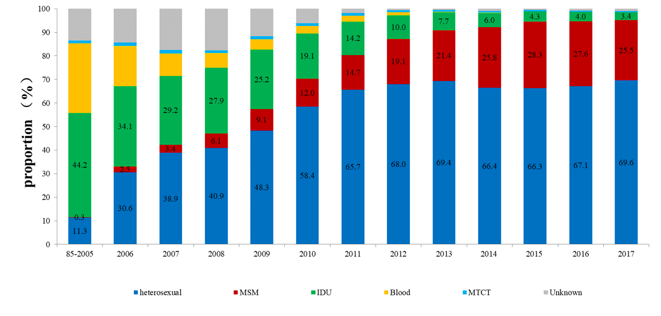
Trend of modes of transmission among newly diagnosed HIV/AIDS cases, 1985 - 2017
95.1%
through sexual transmission
Source: NCAIDS, China CDC

Slide 14
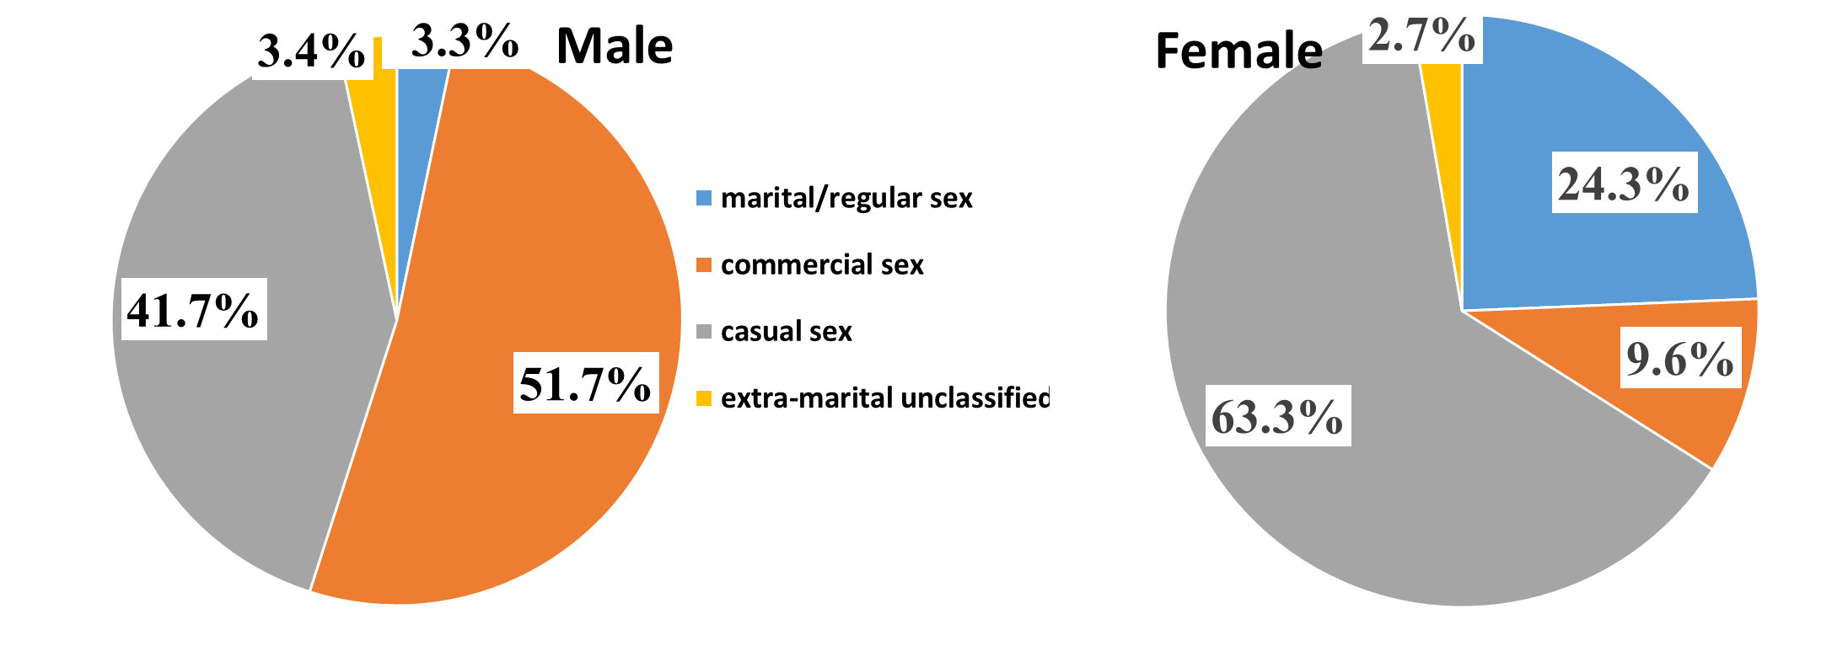
Pattern of heterosexual transmission among newly diagnosed cases in 2017, by gender
Source: NCAIDS, China CDC

Slide 15
Reported number of people living with HIV and AIDS, AIDS patients, and AIDS-related deaths, 2010-2014
Source: Prepared by www.aidsdatahub.org based on Family Planning Commission of The People’s Republic of China. (2015). 2015 China AIDS Response Progress Report

Slide 16
Risk behaviours

Slide 17
Proportion of key populations who reported condom use at last sex, 2004-2014
Source: Prepared by www.aidsdatahub.org based on 1. National HIV Sentinel Surveillance Results, 2004, 2005, 2007 cited in 2005, 2008 and 2010 UNGASS Country Progress Report: China, 2. National HIV Sentinel Surveillance Results, 2010 and 2011 cited in State Council AIDS Working Committee Office China. (2012). China Global AIDS Response Progress Report, 2012; 3. National Sentinel Surveillance 2013; and 4. www.aidsinfoonline.org

Slide 18
Proportion of PWID who reported using sterile injecting equipment,
2007-2014
Source: Prepared by www.aidsdatahub.org based on 1. National HIV Sentinel Surveillance Results, 2007 and 2009 cited in 2008 and 2010 UNGASS Country Progress Report: China, 2. National HIV Sentinel Surveillance Results, 2010 and 2011 cited in State Council AIDS Working Committee Office China. (2012). China Global AIDS Response Progress Report, 2012; 3. National Sentinel Surveillance 2013; and 4. www.aidsinfoonline,org

Slide 19
Trends in condom use at last sex and consistent condom use among MSM, 2005-2011
Source: Prepared by www.aidsdatahub.org based on Lan, W., Lu, W., L.Norris, J., Dong-min, L., Wei, G., Zheng-wei, D., & Ning, W. (2012). HIV Prevalence and Influencing Factors Analysis of Sentinel Surveillane among Men who have Sex with Men in China. Chinese Medical Journal, 125(11), 1857-1861.

Slide 20
Proportion of MSM who are married to female partner and proportion of MSM reported having commercial sex with male partners, 2008-2011
Source: Prepared by www.aidsdatahub.org based on Lan, W., Lu, W., L.Norris, J., Dong-min, L., Wei, G., Zheng-wei, D., & Ning, W. (2012). HIV Prevalence and Influencing Factors Analysis of Sentinel Surveillane among Men who have Sex with Men in China. Chinese Medical Journal, 125(11), 1857-1861.

Slide 21
Proportion of MSM with reported risk behaviors, 2008-2011
Source: Prepared by www.aidsdatahub.org based on Lan, W., Lu, W., L.Norris, J., Dong-min, L., Wei, G., Zheng-wei, D., & Ning, W. (2012). HIV Prevalence and Influencing Factors Analysis of Sentinel Surveillane among Men who have Sex with Men in China. Chinese Medical Journal, 125(11), 1857-1861.

Slide 22
Proportion of FSW who reported consistent condom use with clients in the last month, 1995-2011
Source: Prepared by www.aidsdatahub.org based on power point presentation presented at the NCAIDS training workshop on surveillance 2011(Unpublished)

Slide 23
Vulnerability and
HIV knowledge

Slide 24
Proportion of key populations with comprehensive knowledge of HIV, 2005-2009
Sources: Prepared by www.aidsdatahub.org based on 1. Office of the State Council Working Committee on AIDS China. (2005). Progress on Implementing UNGASS Declaration of Commitment in China 2005, 2, State Council AIDS Working Committee Office China. (2008). UNGASS Country Progress Report: China, and 3. State Council AIDS Working Committee Office China. (2010). UNGASS Country Progress Report: China.

Slide 25
Proportion of MSM who had comprehensive knowledge of HIV by age group, 2007 and 2009
Sources: Prepared by www.aidsdatahub.org based on 1. State Council AIDS Working Committee Office China. (2008). UNGASS Country Progress Report: China, and 2. State Council AIDS Working Committee Office China. (2010). UNGASS Country Progress Report: China.

Slide 26
Proportion of PWID who had comprehensive knowledge of HIV by age group and gender, 2007 and 2009
Sources: Prepared by www.aidsdatahub.org based on 1. State Council AIDS Working Committee Office China. (2008). UNGASS Country Progress Report: China, and 2. State Council AIDS Working Committee Office China. (2010). UNGASS Country Progress Report: China.

Slide 27
Proportion of FSWs who had comprehensive knowledge of HIV by age group, 2007 and 2009
Sources: Prepared by www.aidsdatahub.org based on 1. State Council AIDS Working Committee Office China. (2008). UNGASS Country Progress Report: China, and 2. State Council AIDS Working Committee Office China. (2010). UNGASS Country Progress Report: China.

Slide 28
Proportion of adults (15-49) who had correct knowledge of HIV prevention, 2008
Source: Prepared by www.aidsdatahub.org based on UNAIDS, Global Business Coalition, Century JinQin Marketing Research Company Renmin University, et al. (2008). AIDS-Related Knowledge, Attitudes, Behavior, and Practices: A Survey of 6 Chinese Cities.

Slide 29
HIV Expenditure

Slide 30
AIDS spending by financing source, 2006-2014
Source: Prepared by www.aidsdatahub.org based on UNAIDS 2014 Estimates and Global AIDS Response Progress Reporting

Slide 31
National response

Slide 32
Treatment cascade, 2018
Source: Prepared by www.aidsdatahub.org based on UNAIDS. (2019). UNAIDS 2019 HIV Estimates and Global AIDS Monitoring 2019

Slide 33
ART scale up, 2000-2018
Source: Prepared by www.aidsdatahub.org based on UNAIDS. (2019). UNAIDS 2019 HIV Estimates and Global AIDS Monitoring 2019

Slide 34
Estimated adults living with HIV, adults receiving ARVs, and adult ART coverage, 2018
Source: Prepared by www.aidsdatahub.org based on UNAIDS. (2019). UNAIDS 2019 HIV Estimates and Global AIDS Monitoring 2019

Slide 35
Proportion of key populations reached with HIV prevention programmes, 2007-2014
Source: Prepared by www.aidsdatahub.org based on 1. State Council AIDS Working Committee Office China. (2008). UNGASS Country Progress Report: China; 2. China Comprehensive National Surveillance 2009 cited in 2010 UNGASS Country Progress Report: China, 3. China Comprehensive National Surveillance 2010-2011 cited in State Council AIDS Working Committee Office China. (2012). China Global AIDS Response Progress Report, 2012; 4. National Sentinel Surveillance 2013; and 5. www.aidsinfoonline.org

Slide 36
Proportion of key populations who received an HIV test in the last 12 months and know their results, 2007-2014
Source: Prepared by www.aidsdatahub.org based on 1. State Council AIDS Working Committee Office China. (2012). China Global AIDS Response Progress Report, 2012; 2. National sentinel surveillance 2013; and 3. www.aidsinfoonline.org

Slide 37
Number of needle/syringes distributed per person who inject drugs per year, 2009-2018
Source: Prepared by www.aidsdatahub.org based on 1. WHO, UNAIDS, & UNICEF. (2009). Towards Universal Access: Scaling up Priority HIV/AIDS Interventions in the Health Sector- Progress Report 2009; 2. WHO, UNAIDS, & UNICEF. (2010). Towards Universal Access: Scaling up Priority HIV/AIDS Interventions in the Health Sector - Progress Report 2010; 3. WHO, UNAIDS, & UNICEF. (2011). Global HIV/AIDS Response Epidemic Update and Health Sector Progress towards Universal Access Progress Report 2011; 4. State Council AIDS Working Committee Office China. (2012). China Global AIDS Response Progress Report, 2012; 5. Data presented at the UNAIDS Regional Management Meeting (RMM) held from 25 to 28 October 2014; and 6. Global AIDS Monitoring Reporting and www.aidsinfoonline.org

Slide 38
Number of Needle and Syringe Programme (NSP) and Opioid Substitution Therapy (OST) sites, 2011 - 2014
Source: Prepared by www.aidsdatahub.org based on Global AIDS Response Progress Reporting

Slide 39
Treatment coverage of sero-discordant couples, 2010-2013
Source: Prepared by www.aidsdatahub.org based on National Health and Family Planning Commission of The People’s Republic of China. (2014). 2014 China AIDS Response Progress Report (unpublished)

Slide 40
Cumulative cross-sectional cascade for HIV treatment and care, 2014
Source: Prepared by www.aidsdatahub.org based on Global AIDS Response Progress Reporting 2015

Slide 41
PMTCT coverage and HIV testing coverage among pregnant women, 2014
NOTE: 3,576 pregnant women received ARVs for PMTCT in 2014
Source: Prepared by ww.aidsdatahub.org based on Global AIDS Response Progress Reporting 2015

Slide 42

National data on stigma and discrimination
Selected indicators of response from NCPI 2014
Access to justice:
Legal services (legal aid or other) NHRI or other mechanisms
Civil society perspectives/ratings: | 2009 | 2011 | 2013 | Trend
Laws and policies in place to protect and promote HIV-related human rights | 5/10 | 3/10 | 5/10
Efforts to implement human rights-related laws and policies | 5/10 | 3/10 | 5/10
Source: Prepared by UNAIDS Regional Support Team Asia and the Pacific andwww.aidsdatahub.org based on information provided by UNAIDS country office and partners.

Slide 43

Punitive laws hindering the HIV response
Sources: Prepared by www.aidsdatahub.org based on UNAIDS, UNDP, UNFPA, and UNODC. (2014). Punitive Laws Hindering the HIV Response in Asia and the Pacific in October 2014

Slide 44
THANK YOU
slides compiled by www.aidsdatahub.org
Data shown in this slide set are comprehensive to the extent they are available from country reports. Please inform us if you know of sources where more recent data can be used.
Please acknowledge www.aidsdatahub.org if slides are lifted directly from this site

