Slide 1
AIDS Data Hub App
HIV and AIDS Data Hub for Asia and the Pacific
www.aidsdatahub.org
1 February 2017

Slide 2
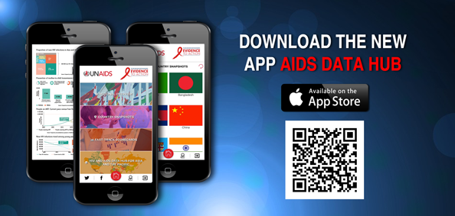
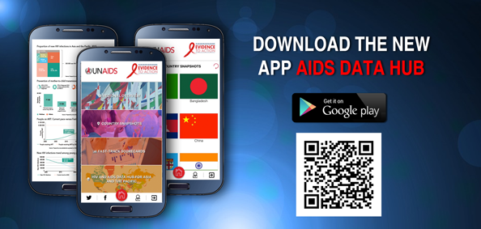
Data Hub's newest feature - the mobile application, AIDS Data Hub app - provides key information on the HIV epidemic in Asia and the Pacific
Available for free download and installation at
App Store for iPhones
Google Play Store for Android Phones
Prepared by www.aidsdatahub.org

Slide 3
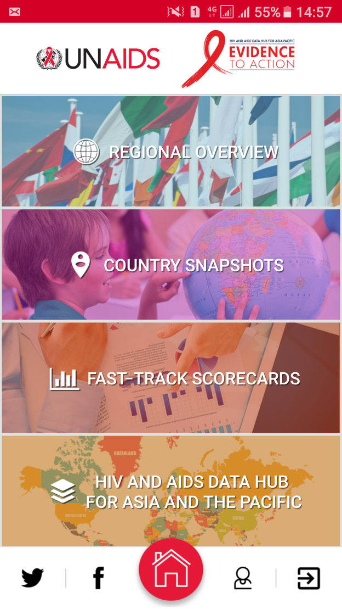

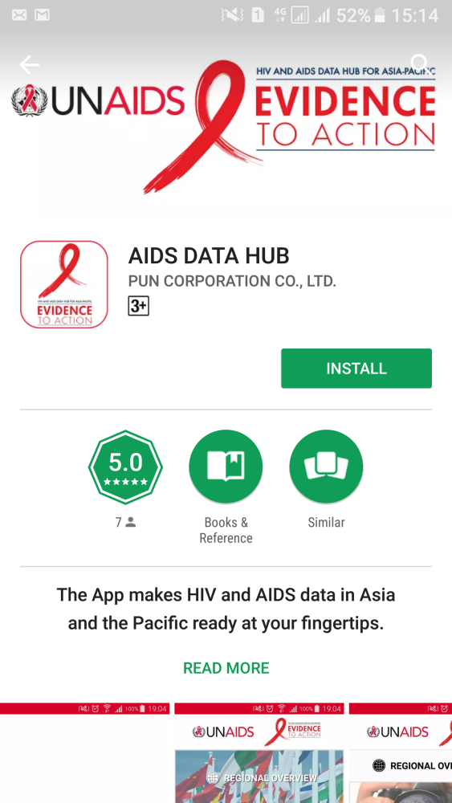
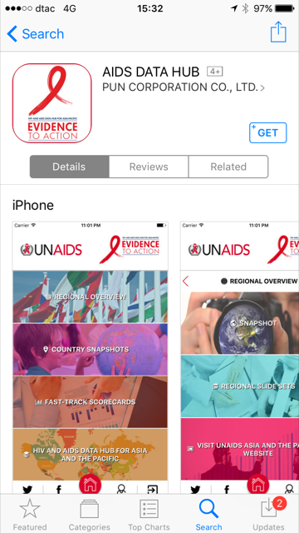
Main features – Regional overview, Country snapshots, Fast-Track scorecards and link to AIDS Data Hub
Google Play Store
iPhone App Store
Prepared by www.aidsdatahub.org

Slide 4
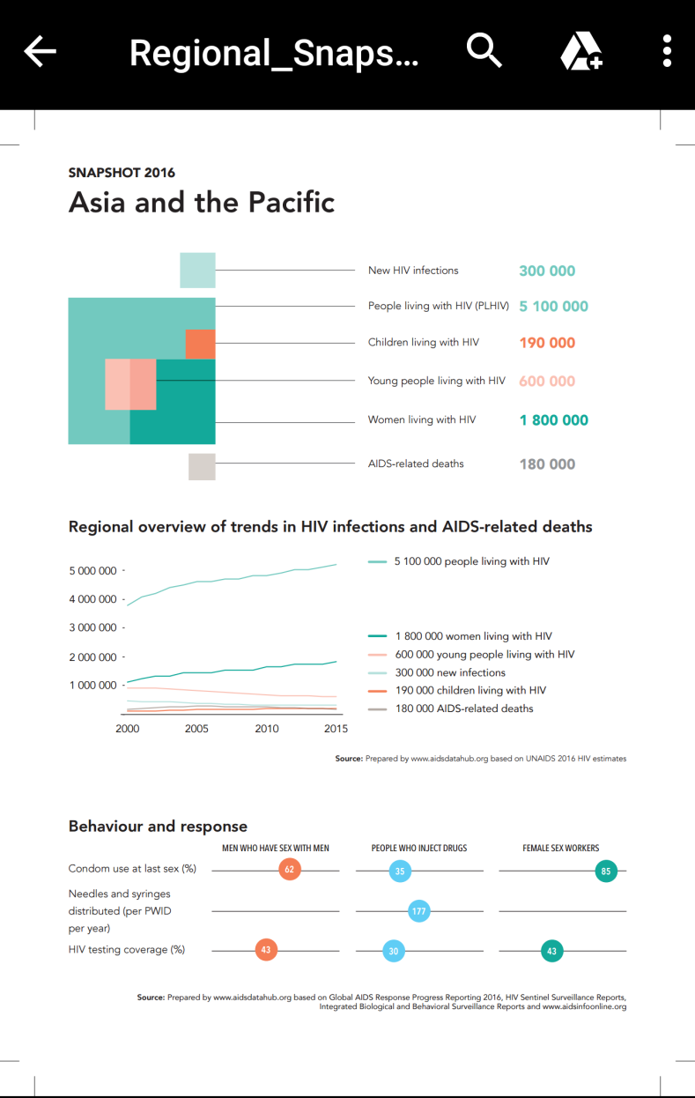

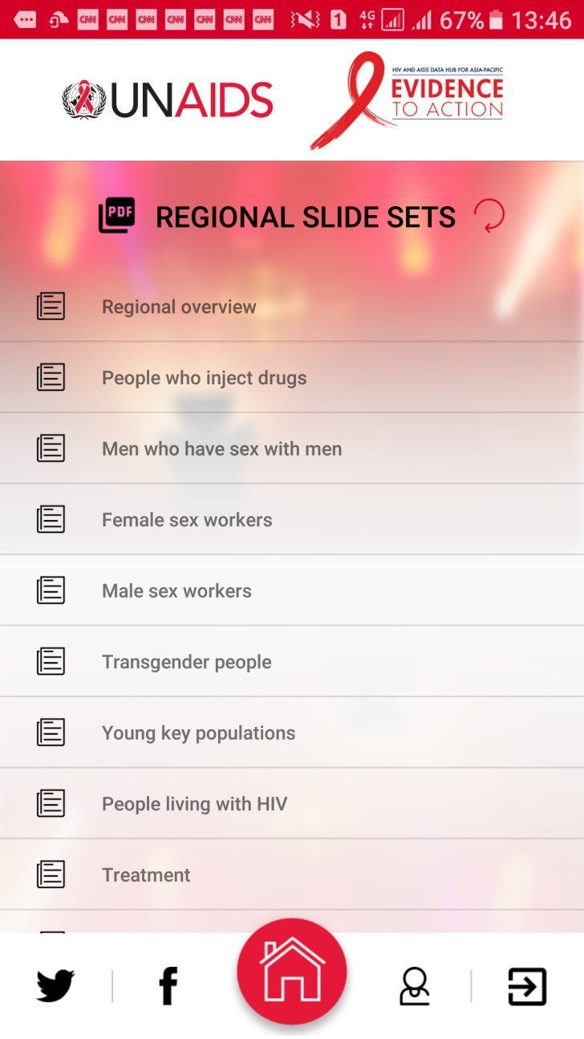
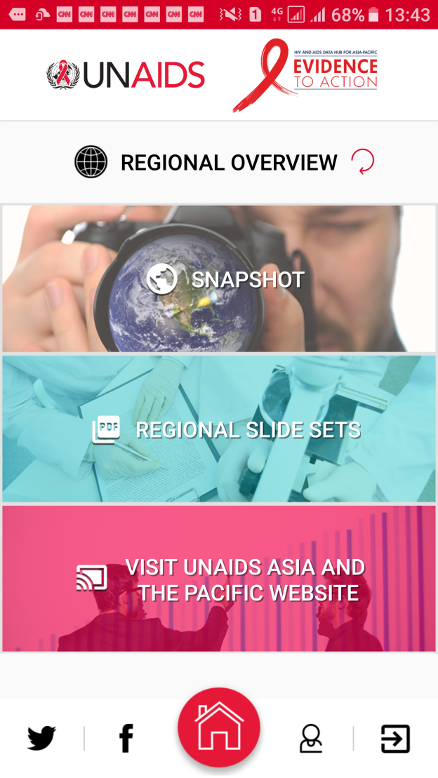
Regional overview: snapshot, key slide sets by population and thematic area, and link to official website of the UNAIDS Regional Support Team for Asia and the Pacific
Prepared by www.aidsdatahub.org

Slide 5
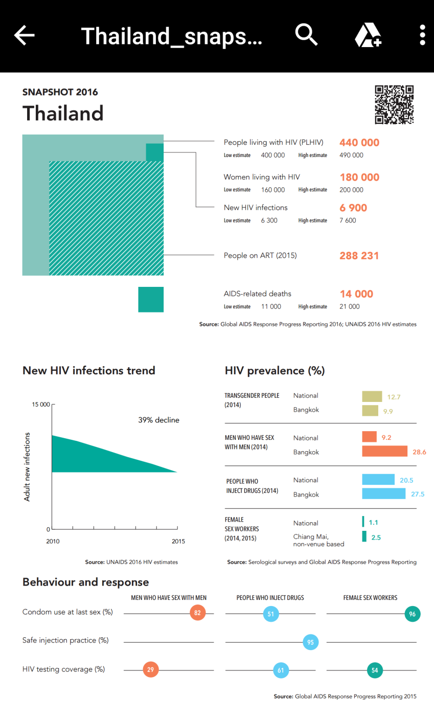
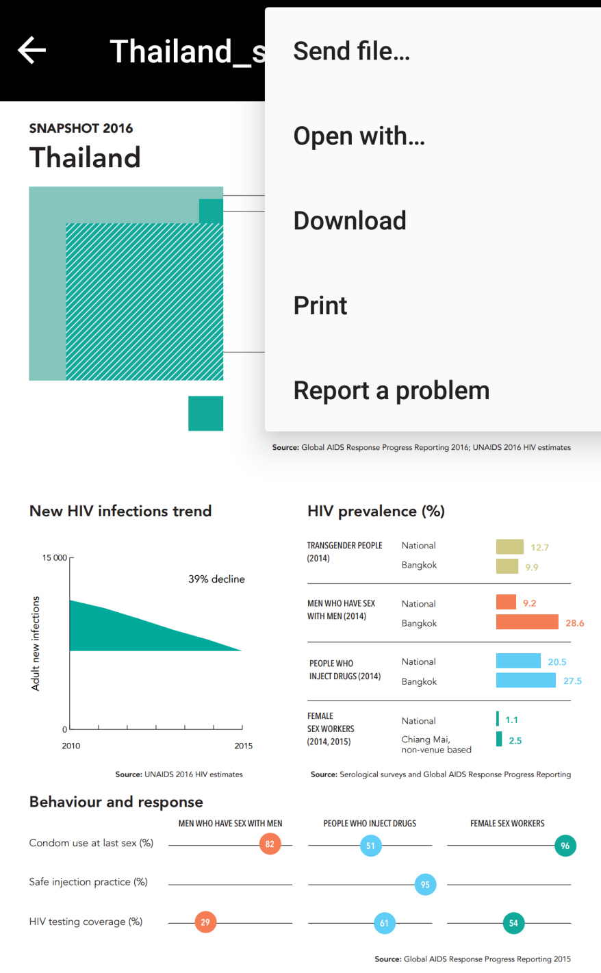

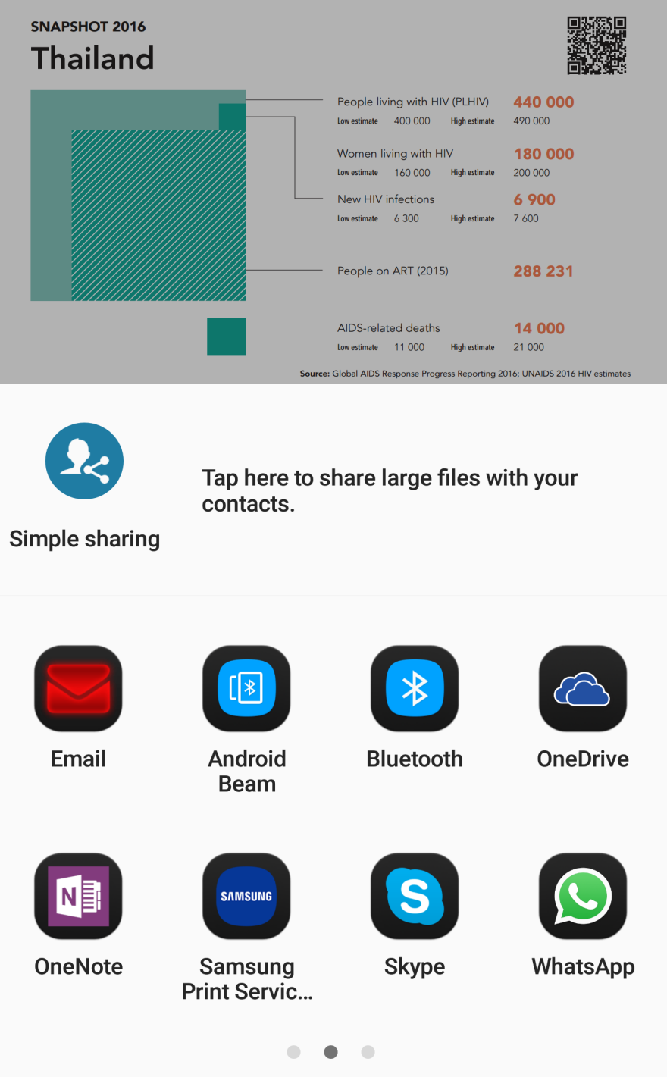
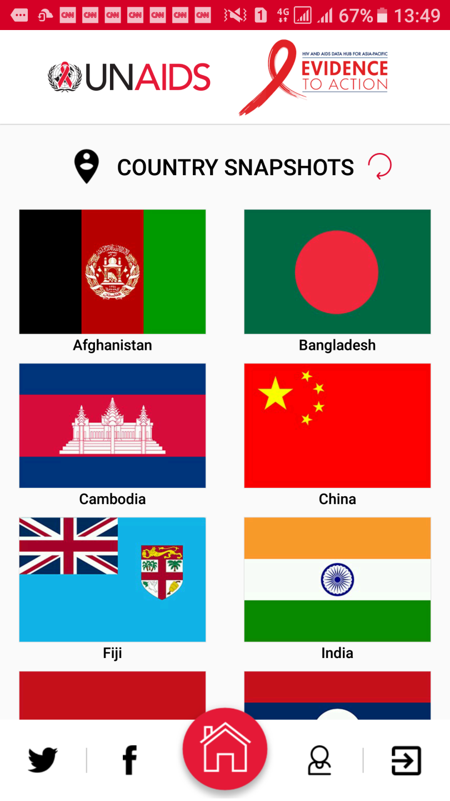
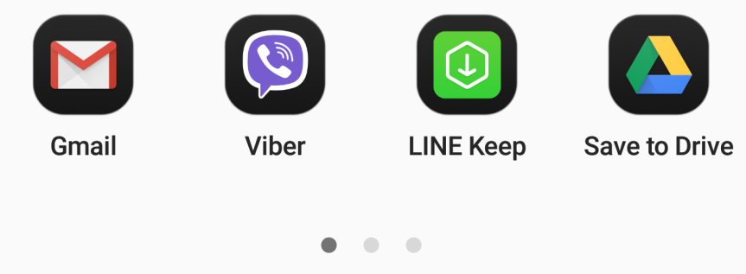
Country snapshots with overview of HIV epidemic and response – available for share, download and print !!!
Scan QR code to access more information on country specific page of AIDS Data Hub website
Prepared by www.aidsdatahub.org

Slide 6
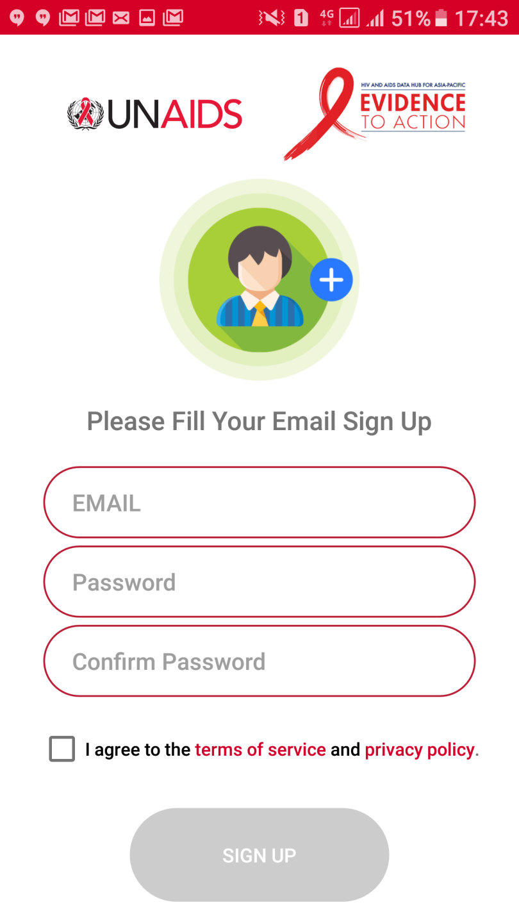
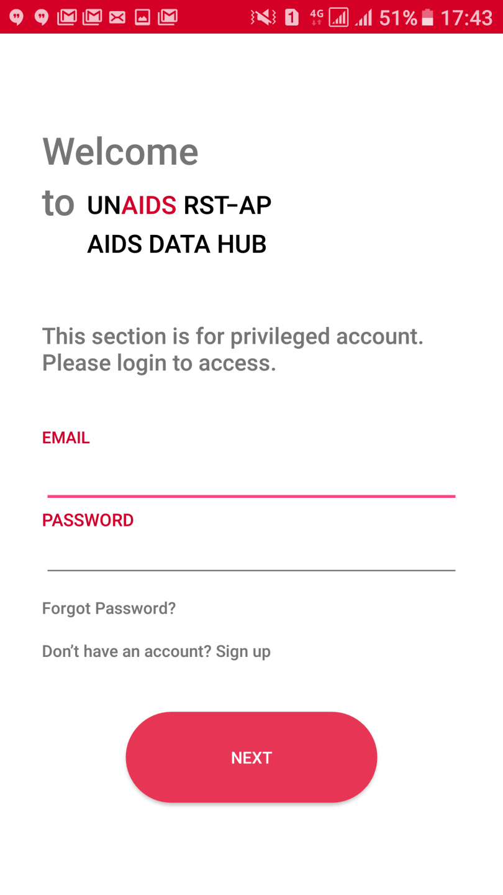

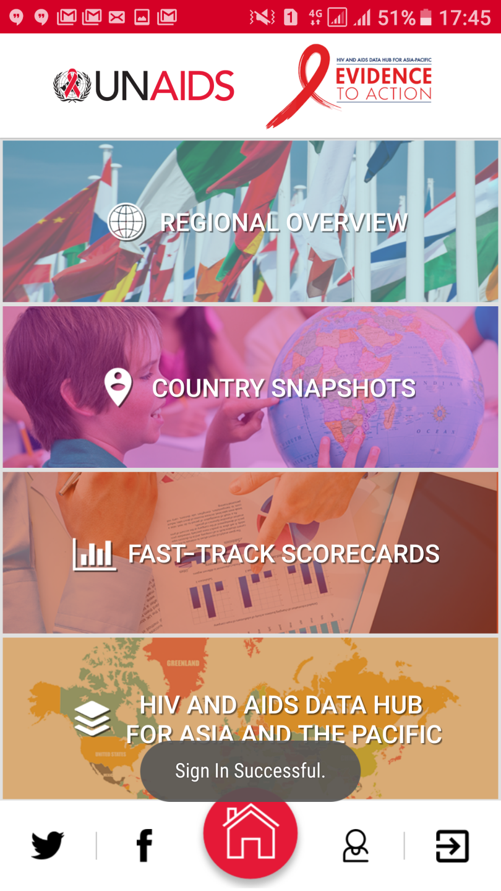
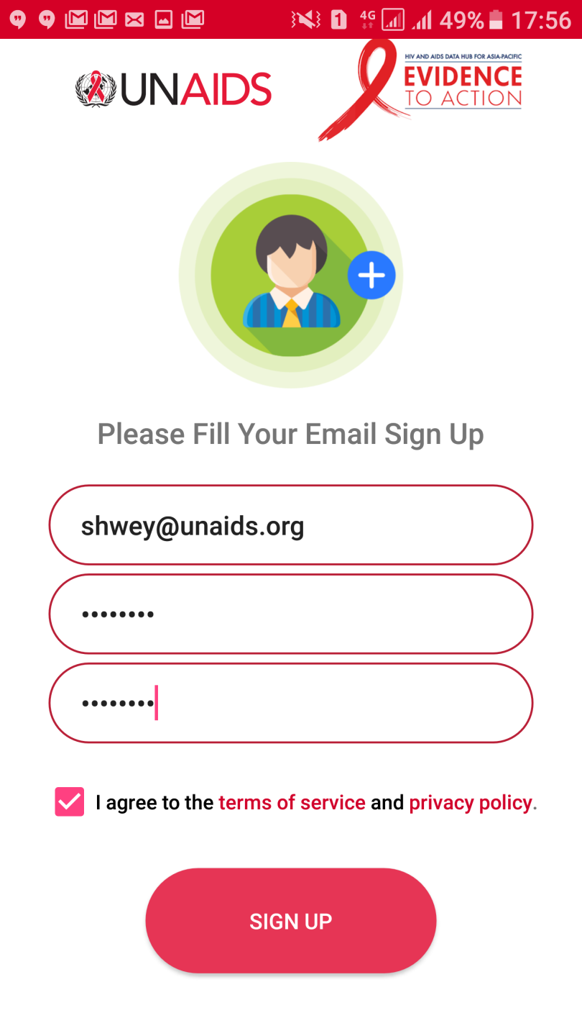
Fast-Track scorecards by country and by Fast-Track commitment
Please provide UNAIDS email address
Password can be any of your choice

Slide 7
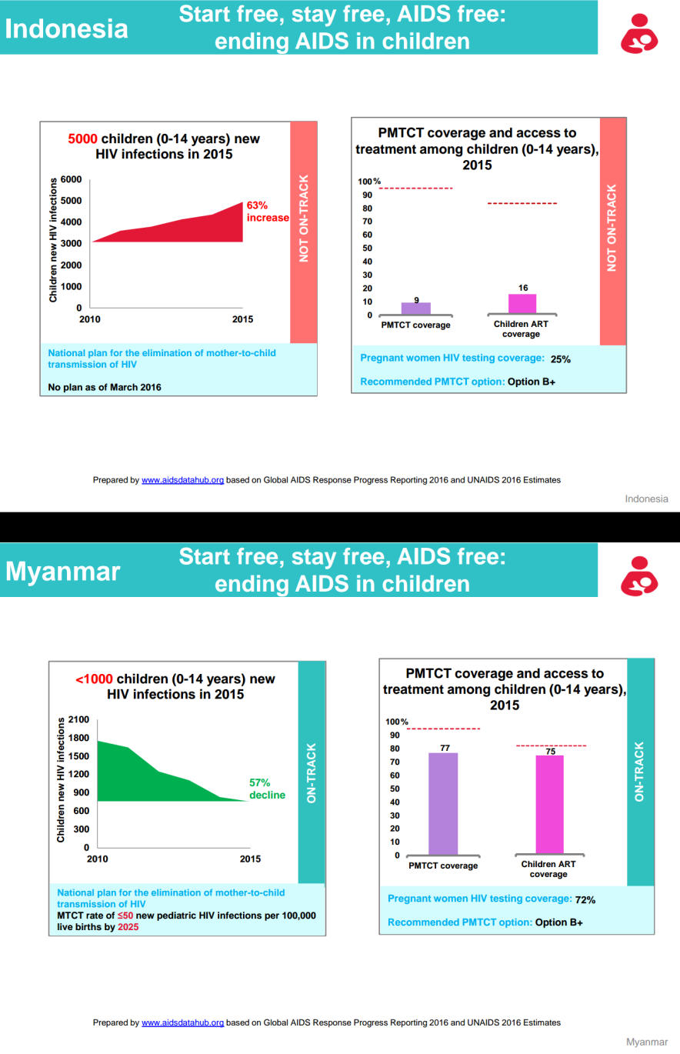
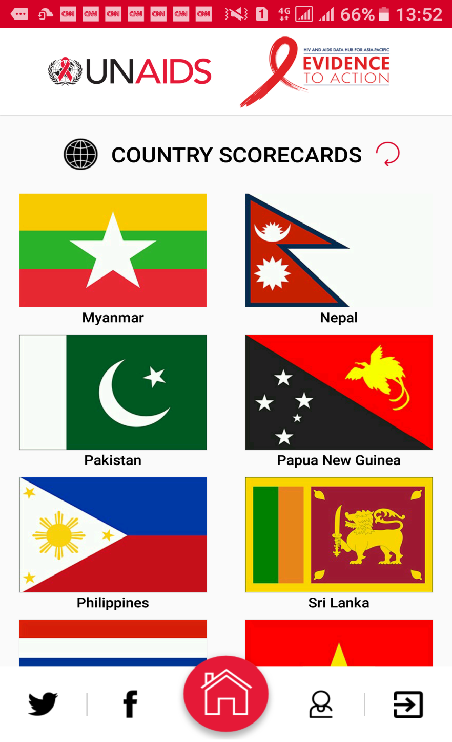
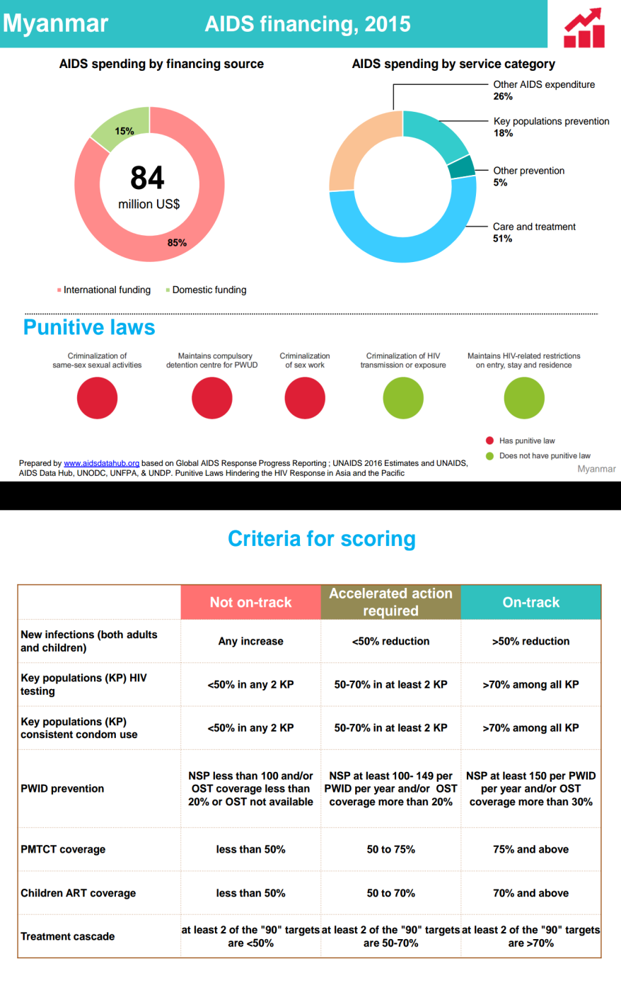
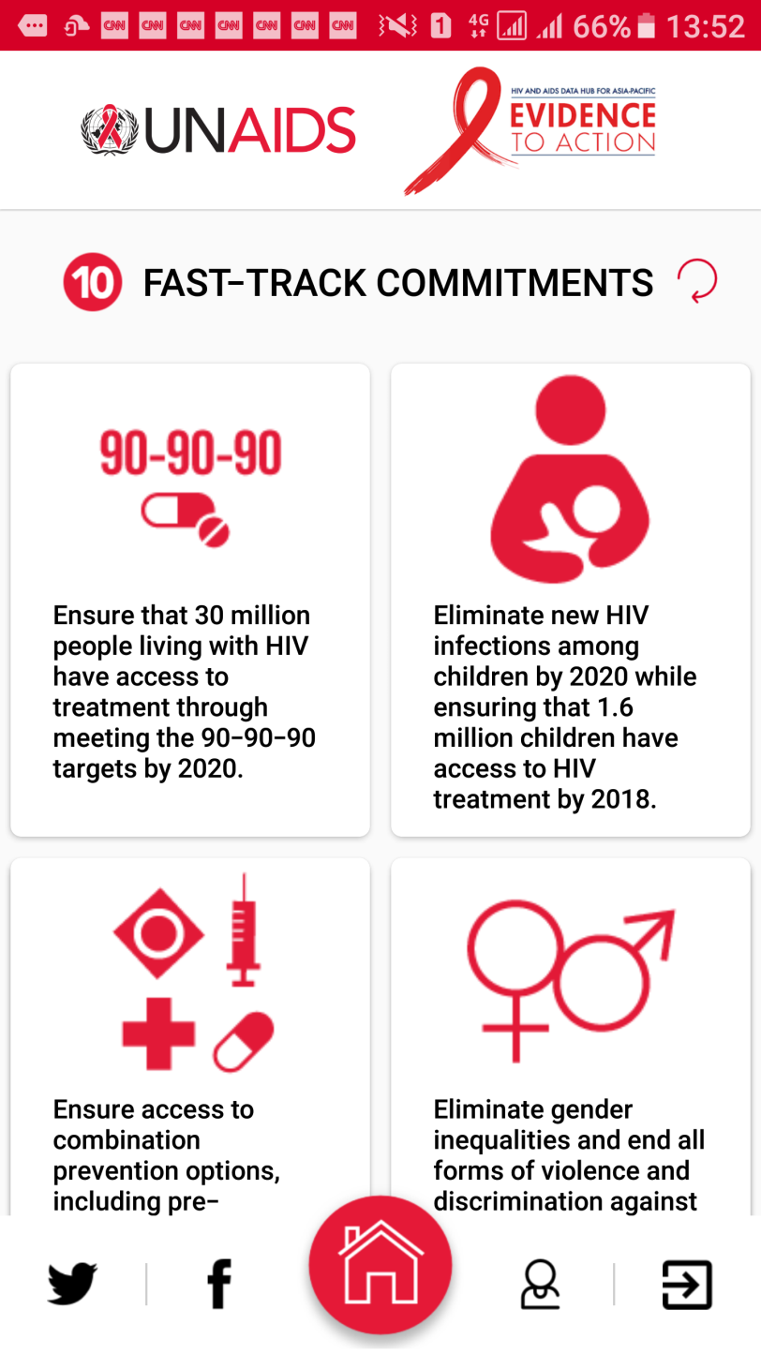
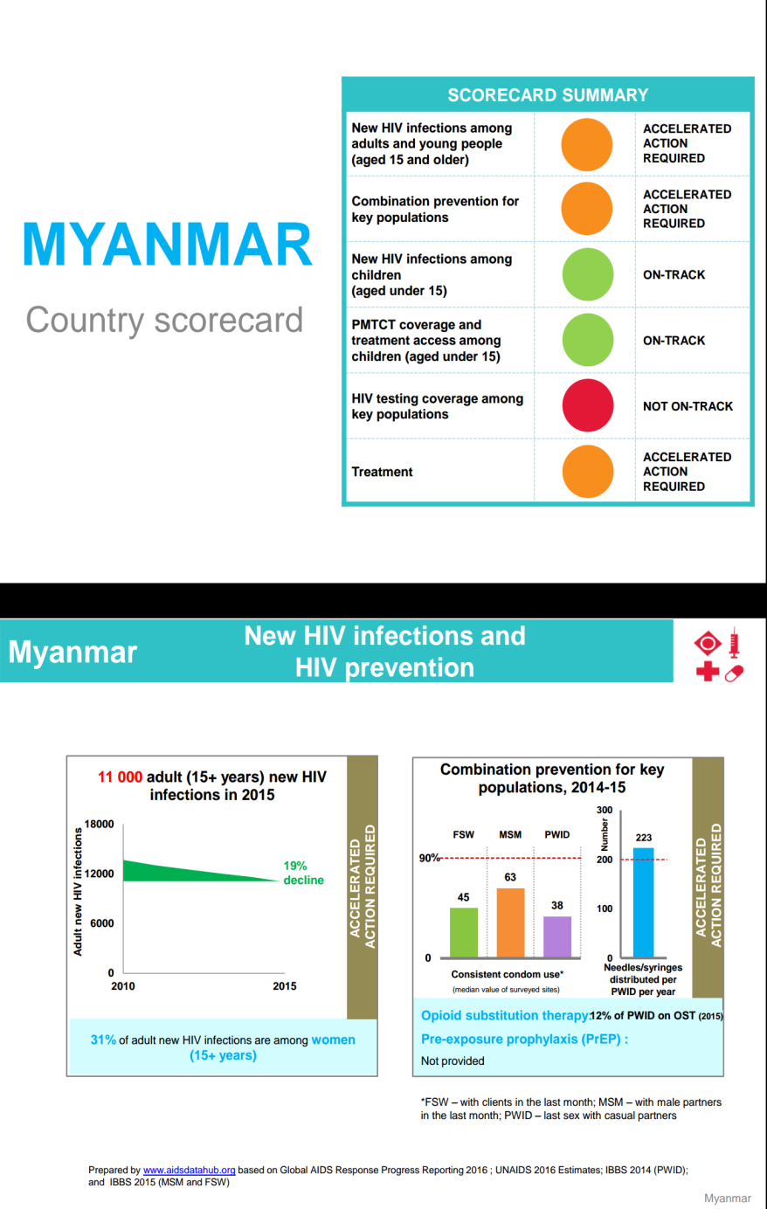
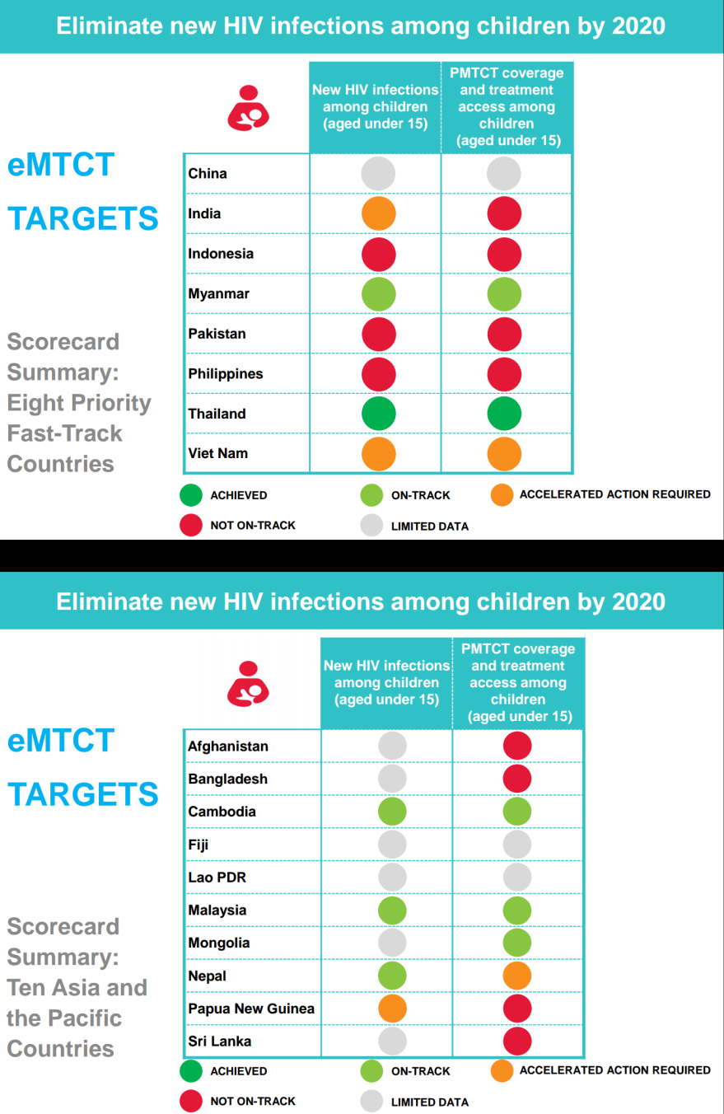
Fast-Track scorecards by country and by Fast-Track commitment
Prepared by www.aidsdatahub.org

Slide 8
Thank you!

