Slide 1
Philippines
Last updated: October 2020

Slide 2
CONTENT
Basic socio-demographic indicators
HIV prevalence and epidemiological status
Risk behaviors
Vulnerability and HIV knowledge
HIV expenditure
National response

Slide 3
BASIC SOCIO-DEMOGRAPHIC INDICATORS
Total population (in thousands) | 100,699 (2015) ¹
Population aged 15-49 (thousands) | 53,037 (2015) ¹
Maternal mortality ratio (per 100 000 live births) | 114 (2015) ⁵
Percentage of population in urban areas | 44 (2015) ²
Antenatal care coverage - At least one visit (%) | 95.4 (2013) ⁷
Crude birth rate (births per 1,000 population) | 23.6 (2014) ²
Under-5 mortality rate (per 1,000 live births) | 28 (2015) ²
Human development index (HDI) - Rank/Value | 115/0.668 (2014) ⁴
Life expectancy at birth (years) - Male/Female | 65/72 (2015) ⁵
Adult literacy rate (%) | 95 (2008) ²
Ratio of girls to boys enrolled at primary level in public and private school (%) | 1.00 (2013) ²
GDP per capita (PPP, current international $) | 7,359 (2015) ²
Per capita total expenditure on health (PPP int. $) | 329 (2014) ³
Sources: Prepared by www.aidsdatahub.org based on 1. UN Population Division. (2015). World Population Prospects: The 2015 Revision - Extended Dataset; 2. World Bank. World Data Bank: World Development Indicators & Global Development Finance. Retrieved July 2016, from http://data.worldbank.org/; 3. WHO. Global Health Observatory Indicator Views: Per Capita Total Expenditure on Health (PPP int. $) (Health Systems), Retrieved July 2016, from http://apps.who.int/gho/data/node.imr.WHS7_105?lang=en; 4. Palanivel, T., Mirza, T., Tiwari, B. N., Standley, S., & Nigam, A. (2016). Asia-Pacific Human Development Report - Shaping the Future: How Changing Demographics Can Power Human Development; 5. WHO. (2016). World Health Statistics 2016: Monitoring health for the SDGs; 6. World Bank Group. (2016). World Development Indicators 2016 and 7. UNSD. Millennium Development Goals Database - Antenatal Care Coverage Retrieved May 2016, from http://data.un.org/Data.aspx?q=Antenatal+care+coverage&d=MDG&f=seriesRowID%3a762.

Slide 4
HIV prevalence and epidemiology

Slide 5
Estimated people living with HIV, new HIV infections and AIDS-related deaths, 1990-2019
Source: Prepared by www.aidsdatahub.org based on UNAIDS. (2020). UNAIDS 2019 HIV Estimates and UNAIDS. (2020). UNAIDS Data 2020.

Slide 6
Estimated people living with HIV, new HIV infections and AIDS-related deaths, 1990-2019
Source: Prepared by www.aidsdatahub.org based on UNAIDS. (2020). UNAIDS 2019 HIV Estimates and UNAIDS. (2020). UNAIDS Data 2020.

Slide 7
Estimated number of adults (15+) living with HIV and women (15+) living with HIV, 1990-2019
Source: Prepared by www.aidsdatahub.org based on UNAIDS. (2020). UNAIDS 2019 HIV Estimates and UNAIDS. (2020). UNAIDS Data 2020.

Slide 8
Key population size estimates, 2015
Key population size estimates
Populations | Estimate | Year of estimate
People who inject drugs (PWID) | 10 000 | 2015
Female sex workers (FSW) | 66 000 | 2015
Men who have sex with men (MSM) | 531 500 | 2015
Male sex workers (MSW) | 86 600 | 2015
Transgender people (TG) | 122 800 | 2015
Source: Prepared by www.aidsdatahub.org based on Global AIDS Monitoring 2018

Slide 9
HIV prevalence among key populations, 2007-2018
Source: Prepared by www.aidsdatahub.org based on Integrated HIV Behavioral and Serologic Surveillance (IHBSS) 2007-2015; Global AIDS Monitoring (GAM)

Slide 10
HIV prevalence among key populations, 2015-2018
TRANSGENDER PEOPLE
(2018)
MEN WHO HAVE SEX
WITH MEN (2018)
PEOPLE WHO
INJECT DRUGS (2015)
FEMALE
SEX WORKERS (2018)
Source: Prepared by www.aidsdatahub.org based on Serological surveys and Global AIDS Monitoring (GAM) Reporting

Slide 11
HIV prevalence among key populations, 2015-2018
Source: Prepared by www.aidsdatahub.org based on Global AIDS Monitoring (GAM) Reporting

Slide 12
HIV prevalence among key populations by age group, 2015-2018
Source: Prepared by www.aidsdatahub.org based on Philippines Integrated HIV Behavioral and Serological Surveillance (IHBSS) 2015 and 2018

Slide 13
High HIV prevalence among key populations in selected cities, 2015-2018
Source: Prepared by www.aidsdatahub.org based on National HIV and STI Surveillance and Strategic Information Unit, Epidemiology Bureau, DOH. (2016). 2015 Integrated HIV Behavioral and Serologic Surveillance (IHBSS) Fact Sheets

Slide 14
HIV prevalence among males who have sex with males in selected cities, 2007-2018
Data from the 2015 and 2018 IHBSS is for a mixed survey sample of males or transgender people who have sex with males (M/TSM). In addition it has been adjusted using Time Location Sampling (TLS) weights, therefore it is not directly comparable to previous IHBSS rounds. *declining between most recent rounds of IHBSS
Source: Prepared by www.aidsdatahub.org based on Integrated HIV Behavioral and Serologic Surveillance (IHBSS) Reports

Slide 15
HIV prevalence among males who have sex with males by age group, 2009-2015
Source: Prepared by www.aidsdatahub.org based on National HIV/AIDS & STI Surveillance and Strategic Information Unit. Epidemiology Bureau, Department of Health. (2016). The growing HIV epidemic among adolescents in the Philippines.

Slide 16
HIV prevalence among FSW by age group, 2011 and 2013
Source: Prepared by www.aidsdatahub.org based on National HIV and STI Surveillance and Strategic Information Unit, National Epidemiology Center, DOH. (2014). 2013 Integrated HIV Behavioral and Serologic Surveillance (IHBSS) Report. Manila, Philippines.

Slide 17
HIV prevalence among male PWID by age group, Cebu City and Mandaue City, 2011 and 2013
Source: Prepared by www.aidsdatahub.org based on National HIV and STI Surveillance and Strategic Information Unit, National Epidemiology Center, DOH. (2013). 2013 IHBBS Briefer. Males who have Sex with Males (MSM) and Male Injecting Drug Users (IDU) - Preliminary report. Manila, Philippines.

Slide 18
HIV prevalence among PWID in selected geographical locations, 2005-2015
* Male PWID; ** Female PWID
Source: Prepared by www.aidsdatahub.org based on Philippines Integrated HIV Behavioral and Serologic Surveillance Reports 2005 to 2015

Slide 19
Syphilis prevalence among key populations in selected cities, 2015
Source: Prepared by www.aidsdatahub.org based on National HIV and STI Surveillance and Strategic Information Unit, Epidemiology Bureau, DOH. (2016). 2015 Integrated HIV Behavioral and Serologic Surveillance (IHBSS) Fact Sheets

Slide 20
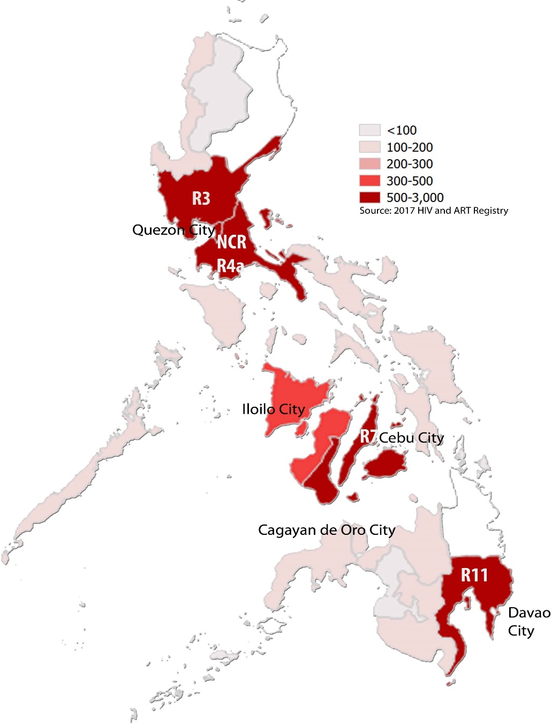
Geographical distribution of reported HIV cases in Philippines, 2017
Source: National Epidemiology Center Philippines. (2018). Philippines HIV/AIDS Registry 2017

Slide 21
Annual number of reported HIV cases, AIDS cases, and AIDS related deaths, 1984 – 2019
Source: Prepared by www.aidsdatahub.org based on National Epidemiology Center Philippines. Philippines HIV/AIDS Registry Reports

Slide 22
Distribution of reported annual HIV cases by mode of transmission, 1984 - 2019
Source: Prepared by www.aidsdatahub.org based on National Epidemiology Center Philippines. Philippines HIV /AIDS Registries, 2008 – 2019

Slide 23
8 in 10 reported HIV cases in Philippines are due to male-to-male sex
Source: Prepared by www.aidsdatahub.org based on National Epidemiology Center Philippines. (2020). Philippines HIV/AIDS Registry: December 2019

Slide 24
Distribution of cumulative HIV cases among children and adolescents by mode of transmission, 1984 – 2019
Source: Prepared by www.aidsdatahub.org based on National Epidemiology Center Philippines. (2020). Philippines HIV/AIDS Registry: December 2019

Slide 25
Proportion of HIV cases among Overseas Filipino workers (OFWs) compared to Non-OFWs, 2000- 2019
Source: Prepared by www.aidsdatahub.org based on National Epidemiology Center Philippines. (2020). Philippines HIV/AIDS Registry: December 2019

Slide 26
Risk behaviours

Slide 27
Proportion of key populations who reported condom use at last sex, 2007-2018
Source: Prepared by www.aidsdatahub.org based on 1. UNAIDS Report on The Global AIDS Epidemic, 2010; and 2. Global AIDS Monitoring (GAM) Reporting

Slide 28
Proportion of FSW who reported condom use behaviors with their clients, 2018
Source: Prepared by www.aidsdatahub.org based on National HIV and STI Surveillance and Strategic Information Unit, National Epidemiology Center, DOH. 2019. 2018 Integrated HIV Behavioral and Serological Surveillance (IHBSS). Factsheets.

Slide 29
Condom use among female sex workers is initiated a few years after their sexual debut
Source: Prepared by www.aidsdatahub.org based on National HIV and STI Surveillance and Strategic Information Unit, National Epidemiology Center, DOH. 2019. 2018 Integrated HIV Behavioral and Serological Surveillance (IHBSS). Factsheets.

Slide 30
Proportion of FSW who reported condom at last sex, by partner type and by city, 2015
Source: Prepared by www.aidsdatahub.org based on National HIV and STI Surveillance and Strategic Information Unit, Epidemiology Bureau, DOH. (2016). 2015 Integrated HIV Behavioral and Serologic Surveillance (IHBSS) Fact Sheets.

Slide 31
Proportion of males and transgender women who have sex with males who reporting their condom use behaviors, 2018
Source: Prepared by www.aidsdatahub.org based on National HIV and STI Surveillance and Strategic Information Unit, National Epidemiology Center, DOH. 2019. 2018 Integrated HIV Behavioral and Serological Surveillance (IHBSS). Factsheets.

Slide 32
Proportion of MSM who reported condom use at last sex with a male partner, by age group, 2013 - 2018
* Data from the 2015 and 2018 IHBSS is for a mixed survey sample of males or transgenders who have sex with males (M/TSM).
Source: Prepared by www.aidsdatahub.org based on Global AIDS Monitoring (GAM)

Slide 33
Proportion of PWID who reported condom use at last sex by partner type and city, 2015
Source: Prepared by www.aidsdatahub.org based on National HIV and STI Surveillance and Strategic Information Unit, Epidemiology Bureau, DOH. (2016). 2015 Integrated HIV Behavioral and Serologic Surveillance (IHBSS) Fact Sheets.

Slide 34
Proportion of male entertainment establishment workers who reported condom use at last sex by partner type and by city, 2015
Source: Prepared by www.aidsdatahub.org based on National HIV and STI Surveillance and Strategic Information Unit, Epidemiology Bureau, DOH. (2016). 2015 Integrated HIV Behavioral and Serologic Surveillance (IHBSS) Fact Sheets.

Slide 35
Proportion of transgender women who reported condom use at last sex, 2018
Source: Prepared by www.aidsdatahub.org based on Global AIDS Monitoring (GAM)

Slide 36
Proportion of PWID who reported using sterile injecting equipment at the last time that they injected, 2007-2015
Source: Prepared by www.aidsdatahub.org based on 1) UNAIDS Report on The Global AIDS Epidemic, 2010; and 2) www.aidsinfoonline.org

Slide 37
Proportion of key populations with reported drug use behaviors in the last 12 months, 2013
Source: Prepared by www.aidsdatahub.org based on 1) National HIV and STI Surveillance and Strategic Information Unit, National Epidemiology Center, DOH. (2014). 2013 Integrated HIV Behavioral and Serologic Surveillance (IHBSS) Report. Manila, Philippines; and 2) National HIV and STI Surveillance and Strategic Information Unit, Epidemiology Bureau, DOH. (2016). 2015 Integrated HIV Behavioral and Serologic Surveillance (IHBSS) Fact Sheets.

Slide 38
Proportion of males who have sex with males who engaged in transactional sex in the last year, selected cities, 2018
Note: Survey included males or transgenders who have sex with males
Source: Prepared by www.aidsdatahub.org based on National HIV and STI Surveillance and Strategic Information Unit, National Epidemiology Center, DOH. 2019. 2018 Integrated HIV Behavioral and Serological Surveillance (IHBSS). Factsheets.

Slide 39
Median number of sexual partners reported among surveyed key populations, 2015
Source: Prepared by www.aidsdatahub.org based on National HIV and STI Surveillance and Strategic Information Unit, Epidemiology Bureau, DOH. (2016). 2015 Integrated HIV Behavioral and Serologic Surveillance (IHBSS) Fact Sheets.

Slide 40
Proportion of young women (15-24) who had premarital sex in the past 12 months, and used condom at last sex by age group and residence, 2017
Source: Prepared by www.aidsdatahub.org based on Philippine Statistics Authority (PSA) and ICF. (2018). Philippines National Demographic and Health Survey 2017. Quezon City, Philippines, and Rockville, Maryland, USA: PSA and ICF.

Slide 41
Vulnerability and HIV knowledge

Slide 42
Proportion of key populations with comprehensive HIV knowledge, 2011-2015
Source: Prepared by www.aidsdatahub.org based on Integrated HIV Behavioral and Serologic Surveillance (IHBSS) Reports

Slide 43
Proportion of key populations with comprehensive knowledge of HIV by age group, 2013
Source: Prepared by www.aidsdatahub.org based on National HIV and STI Surveillance and Strategic Information Unit, National Epidemiology Center, DOH. (2014). 2013 Integrated HIV Behavioral and Serologic Surveillance (IHBSS) Report. Manila, Philippines.

Slide 44
Proportion of key populations with comprehensive HIV knowledge, selected cities, 2015-2018
Source: Prepared by www.aidsdatahub.org based on Philippines Integrated HIV Behavioral and Serologic Surveillance (IHBSS) 2015 and 2018

Slide 45
HIV expenditure

Slide 46
AIDS Spending by financing source, 2005-2017
Source: Prepared by www.aidsdatahub.org based on www.aidsinfoonline.org and NASA 2015 and 2017

Slide 47
AIDS Spending by financing source, 2005-2013
Source: Prepared by www.aidsdatahub.org based on www.aidsinfoonline.org

Slide 48
AIDS spending by category, 2005-2013
Source: Prepared by www.aidsdatahub.org based on www.aidsinfoonline.org

Slide 49
Proportion of total prevention programme spending on key populations at higher risk, 2005-2013
Source: Prepared by www.aidsdatahub.org based on www.aidsinfoonline.org

Slide 50
Proportion of spending on HIV prevention programmes from domestic and international sources, 2005 - 2013
Source: Prepared by www.aidsdatahub.org based on www.aidsinfoonline.org

Slide 51
Proportion of spending on care and treatment from domestic and international sources, 2005 - 2013
Source: Prepared by www.aidsdatahub.org based on www.aidsinfoonline.org

Slide 52
National response

Slide 53
Proportion of key populations reached with HIV prevention programmes, 2007-2018
Note: From 2007 to 2013, “reached with HIV prevention programmes” was based on the answer “yes” to the following 2 questions
Do you know where you can go to if you wish to receive an HIV test
In the last 12 months, have you been given condoms
From 2015, the indicator definition was modified so that it measured the proportion of a key population group who reported receiving at least 2 out of 3 HIV prevention services from an NGO, health care provider or other sources in the last 3 months. The 3 HIV prevention services include 1) receiving condoms and lubricant; 2) receiving counselling on condom use and safe sex; and 3) tested for STIs
Source: Prepared by www.aidsdatahub.org based on Integrated HIV Behavioral and Serologic Surveillance (IHBSS) and Global AIDS Monitoring (GAM)

Slide 54
Number of needle/syringes distributed per person who inject drugs per year
Source: Prepared by www.aidsdatahub.org based on 1. WHO, UNAIDS, & UNICEF. (2009). Towards Universal Access: Scaling up Priority HIV/AIDS Interventions in the Health Sector- Progress Report 2009; 2. WHO, UNAIDS, & UNICEF. (2010). Towards Universal Access: Scaling up Priority HIV/AIDS Interventions in the Health Sector - Progress Report 2010

Slide 55
Proportion of key populations who received an HIV test in the last 12 months and knew their results, 2007-2018
Source: Prepared by www.aidsdatahub.org based on 1) UNAIDS Report on the Global AIDS Epidemic, 2010; and 2) www.aidsinfoonline.org

Slide 56
Proportion of key populations who received an HIV test in the last 12 months, selected cities, 2015 -2018
Source: Prepared by www.aidsdatahub.org based on 1. National HIV and STI Surveillance and Strategic Information Unit, Epidemiology Bureau, DOH. (2016). 2015 Integrated HIV Behavioral and Serologic Surveillance (IHBSS) Fact Sheets; and 2. National HIV and STI Surveillance and Strategic Information Unit, National Epidemiology Center, DOH. (2019). 2018 Integrated HIV Behavioral and Serological Surveillance (IHBSS). Factsheets.

Slide 57
Number of ART sites and people on ART, 2000-2019
* Includes treatment hubs and satellites
Source: Prepared by www.aidsdatahub.org based on UNAIDS. (2020). UNAIDS HIV Estimates 1990 – 2019 and Philippines AIDS registry reports

Slide 58
ART scale up, 2000-2019
Source: Prepared by www.aidsdatahub.org based on UNAIDS. (2020). UNAIDS 2019 HIV Estimates and http://aidsinfo.unaids.org/

Slide 59
ART coverage trends among children, adult males and females and all ages, 2000 - 2019
Source: Prepared by www.aidsdatahub.org based on UNAIDS. (2020). UNAIDS 2019 HIV Estimates and http://aidsinfo.unaids.org/

Slide 60
Estimated adults living with HIV, adults receiving ARVs, and adult ART coverage, 2019
Source: Prepared by www.aidsdatahub.org based on UNAIDS. (2020). UNAIDS 2019 HIV Estimates and http://aidsinfo.unaids.org/

Slide 61
Treatment cascade, 2019
Source: Prepared by www.aidsdatahub.org based on 1. UNAIDS. (2020). UNAIDS 2019 HIV Estimates; 2. http://aidsinfo.unaids.org/ and 3. Global AIDS Monitoring (GAM) 2020

Slide 62
HIV testing and treatment cascade, 2019
Source: Prepared by www.aidsdatahub.org based on UNAIDS. (2020). UNAIDS 2019 HIV Estimates and UNAIDS. (2020). UNAIDS Data 2020.

Slide 63
Estimated number of pregnant women living with HIV, pregnant women receiving ARVs, and PMTCT coverage, 2019
Source: Prepared by www.aidsdatahub.org based on UNAIDS. (2020). UNAIDS 2019 HIV Estimates and UNAIDS. (2020). UNAIDS Data 2020.

Slide 64
PMTCT cascade, 2019
Source: Prepared by www.aidsdatahub.org based on 1. UNAIDS. (2020). UNAIDS 2019 HIV Estimates; 2. http://aidsinfo.unaids.org/ and 3. Global AIDS Monitoring (GAM) 2020

Slide 65
National data on stigma and discrimination
Selected indicators of response from NCPI 2014
Access to justice:
Legal services (legal aid or other) NHRI or other mechanisms
Civil society perspectives/ratings: | 2009 | 2011 | 2013 | Trend
Laws and policies in place to protect and promote HIV-related human rights | 2/10 | 3/10 | 2/10
Efforts to implement human rights-related laws and policies | 2/10 | 3/10 | 2/10
STIGMA INDEX (2009-10 Data)
Percent of PLHIV respondents who avoided going to a local clinic when needed because of HIV status: 20%
Source: Prepared by UNAIDS Regional Support Team Asia and the Pacific andwww.aidsdatahub.org based on information provided by UNAIDS country office and partners

Slide 66
THANK YOU
slides compiled by www.aidsdatahub.org
Data shown in this slide set are comprehensive to the extent they are available from country reports. Please inform us if you know of sources where more recent data can be used.
Please acknowledge www.aidsdatahub.org if slides are lifted directly from this site.

