Slide 1
Treatment
Last updated: November 2018

Slide 2
CONTENT
Treatment: Antiretroviral therapy
Treatment: PMTCT
Treatment: TB-HIV Co-treatment

Slide 3
Treatment: Antiretroviral therapy

Slide 4
HIV testing is the entry point for prevention and treatment but about half of key populations do not know their HIV status
HIV testing coverage among key populations, 2014 - 2017
Source: Prepared by www.aidsdatahub.org based on Global AIDS Monitoring (GAM) Reporting 2017 and 2018

Slide 5
HIV testing is the entry point for prevention and treatment, but many key populations do not know their HIV status
Female sex workers
Male sex workers
Men who have sex
with men
Transgender people
People who inject
drugs
90%
90%
90%
90%
90%
Prepared by www.aidsdatahub.org based on Global AIDS Monitoring 2018; Integrated Bio-Behavioural Surveys; and Behavioural Surveillance Surveys

Slide 6
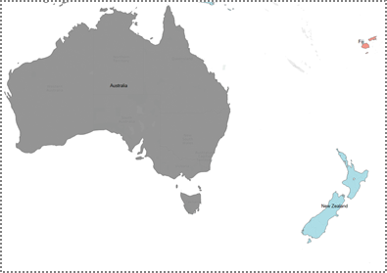
Availability of community-based and lay provider testing approaches in Asia and the Pacific,2018
Both community-based and lay provider HIV testing available
Community-based HIV testing available
Lay provider HIV testing available
Not available
No info
Source: www.aidsdatahub.org based on Global AIDS Monitoring (GAM) 2018

Slide 7
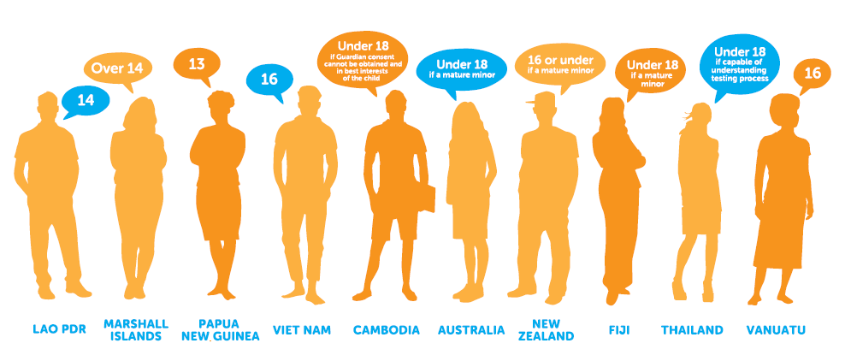
Independent access to HIV testing and related services for young people in Asia and the Pacific
Age of legal capacity to consent independently to an HIV test, Asia and the Pacific
Source: UNICEF, UNESCO, UNFPA, UNODC, Youth LEAD, & Youth Voices Count. (2015). Adolescents Under the Radar in the Asia-Pacific AIDS Response.

Slide 8
Fast-Track Treatment to Reach 90–90–90 by 2020
People receiving ART in Asia and the Pacific
Fast-Track Target 2020:
4.2 million
people on ART
At current pace:
3.4 million
people on ART
by 2020
2017 estimate:
2.7 million
14% annual increase
between 2013 and 2017
Source: Prepared by www.aidsdatahub.org based on UNAIDS 2018 HIV Estimates; Global AIDS Monitoring (GAM) 2018

Slide 9
Progress towards the 90–90–90 targets: Global versus Asia and the Pacific, 2017
Global
75%
[55 – 92%]
79%
[59 – >95%]
81%
[60 – >95%]
Asia and the Pacific
74%
[52 – >95%]
71%
[50 – >95%]
85%
[60 – >95%]
Source: Prepared by www.aidsdatahub.org based on UNAIDS special analysis, 2018
of people living with HIV know their status
of people living with HIV who know their status are on treatment
of people on treatment are virally suppressed

Slide 10
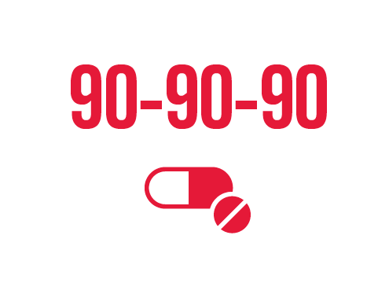
Asia and the Pacific
Towards 90-90-90 Fast-Track
treatment targets
Treatment cascade, 2017
5.2 M
74%
71%
85%
0
Estimated
PLHIV
PLHIV know their status
People on ART
Tested for viral load*
Suppressed viral load
Countries with CD4 threshold policy for treatment initiation
countries have national policy on routine viral load
monitoring for antiretroviral therapy
2016
2018
15
30
* China and India do not report viral load testing data in 2018 GAM reporting. Estimated 55% of PLHIV who are on treatment in 13 reported countries had tested for viral load in the past 12 months.
treat all regardless of CD4
6
0
CD4 ≤ 500 but treat all key populations regardless of CD4
9
2
CD4 ≤ 500
2
0
CD4 ≤ 350 but treat all key populations regardless of CD4
25
Prepared by www.aidsdatahub.org based on Global AIDS Monitoring 2018 Reporting and UNAIDS 2018 HIV Estimates

Slide 11
Regional overview: 90-90-90 target and gaps
HIV testing and treatment cascade, Asia and the Pacific, 2017
0.8 million
1.5 million
1.4 million
3.8 million
2.7 million
2.3 million
ACHIEVED
ACHIEVED
ACHIEVED
Singapore; Thailand
Cambodia
Cambodia
NOT ON-TRACK (<50%)
NOT ON-TRACK (<30%)
NOT ON-TRACK (<30%)
Bangladesh; Indonesia; Mongolia; Pakistan
Bangladesh; Indonesia; Mongolia; Pakistan
Pakistan
Prepared by www.aidsdatahub.org based on UNAIDS special analysis 2018; UNAIDS 2018 estimates and Global AIDS Monitoring 2018
DATA NOT AVAILABLE
DATA NOT AVAILABLE
DATA NOT AVAILABLE
Afghanistan; Australia; China; Japan; Myanmar; New Zealand; PNG; Viet Nam
Afghanistan; China; Japan; New Zealand; PNG
Afghanistan; Australia; Bangladesh; China; Indonesia; Japan; Mongolia; Myanmar; New Zealand; PNG; Philippines

Slide 12
Current treatment scale-up has made significant achievement but the region is lagging behind the global trend
ART coverage and treatment gap, Asia and the Pacific, 2017
ART coverage (%)
Treatment gap
Prepared by www.aidsdatahub.org based on Global AIDS Monitoring 2018 Reporting and UNAIDS 2018 HIV Estimates

Slide 13
Variation in achievement of 2nd 90 treatment (81% of ART coverage) among children living with HIV, 2017
Percentage of children living with HIV receiving ART, 2017
2nd 90
target
Prepared by www.aidsdatahub.org based on UNAIDS 2018 estimates and Global AIDS Monitoring 2018

Slide 14
Low level of access to treatment among key populations
ART coverage: Female sex workers living with HIV vs.
women (15+) living with HIV, 2017
81%
Prepared by www.aidsdatahub.org based on Global AIDS Monitoring 2018

Slide 15
Low level of access to treatment among key populations
ART coverage: Male key populations living with HIV vs.
men (15+) living with HIV, 2017
81%
Prepared by www.aidsdatahub.org based on Global AIDS Monitoring 2018

Slide 16
Late diagnosis: up to 50% of PLHIV have the initial CD4 count of <200 cells/mm³ in 2017
Prepared by www.aidsdatahub.org based on Global AIDS Monitoring Reporting 2018

Slide 17
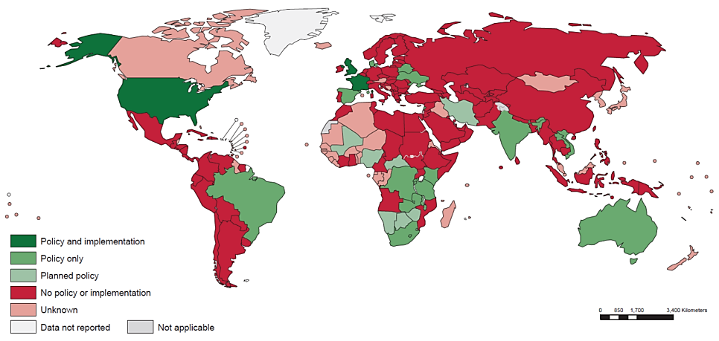
HIV self-testing policy landscape, 2016
As of October 2016, 4 countries in Asia and the Pacific report
having policies supportive of HIV self-testing
*
* HIV self-testing in Thailand is under consideration
Source: WHO.(2016). Overview of the New Guidelines on HIV Self-Testing and Partner Notification: What You Need to Know

Slide 18
Generic competition lowers live-saving ART prices
Evolution in price of different first-line regimens
X 10
times lower
Prepared by www.aidsdatahub.org based on Medecins Sans Frontieres (MSF) (2016). Untangling the Web of Antiretroviral Price Reductions -18th Edition

Slide 19
Generic ARVs and impact on government budget: Thailand example
Cost saving comparing with originated product price
Antiretroviral drug (GUL- Government use of license)
Year | Cost saving
 | Mil THB | Mil USD
2010 | 866.3 | 27.3
2011 | 1,732.8 | 56.8
2012 | 2,319.0 | 74.6
2013 | 2,377.1 | 77.3
2014 | 2,870.0 | 88.4
Total saving | 10,165.2 | 338.8
Source: Presentation by Chutima Akaleephan presented at the Regional Experts Consultation on Access to Affordable Medicines, Diagnostics and Vaccines in Bangkok, March 2016 based on NHSO Thailand data

Slide 20
Newer, more effective, less toxic medicines often unaffordable for the poor and developing countries
X17.4
X6.5
US$ per person per year
X2.7
First-line regimen
Second-line regimen
Third-line regimen
Prepared by www.aidsdatahub.org based on Medecins Sans Frontieres (MSF) (2016). Untangling the Web of Antiretroviral Price Reductions -18th Edition

Slide 21
High out of pocket health payment in countries with highest HIV burden
Out-of-pocket payment as % of total health expenditure
Prepared by www.aidsdatahub.org based on http://www.who.int/gho/database/en/

Slide 22
Treatment: PMTCT

Slide 23
Estimated new HIV infections among children (0-14 years) in Asia and the Pacific: current trend and trend to Fast-Track target
Estimate 2017:
10 000
2020 estimate based on current trend:
8 000
new HIV infections
Falls short of target by:
6 000
Fast-Track Target 2020:
1900
new HIV infections
Source: Prepared by www.aidsdatahub.org based on UNAIDS 2018 HIV Estimates

Slide 24
Efforts are needed to eliminate new HIV infections among children (0-14 years) in Asia and the Pacific
Prevention of mother-to-child transmission (PMTCT) coverage,
Global and Asia and the Pacific, 2010-2017
Prepared by www.aidsdatahub.org based on Global AIDS Monitoring 2018 Reporting and UNAIDS 2018 HIV Estimates

Slide 25
Towards ending AIDS in children starts with mothers: time to improve linkages and prevent leakages
Service cascade of prevention of mother-to-child transmission of HIV in Asia and the Pacific, 2017
56% received ARVs for PMTCT
45% early infant diagnosis
Note: Coverage of infant ARV prophylaxis is not captured in GAM 2018 reporting
Prepared by www.aidsdatahub.org based on Global AIDS Monitoring 2018 Reporting and UNAIDS 2018 HIV Estimates

Slide 26
Regional overview: Prevention of mother-to-child transmission
Pregnant women living with HIV who received ARVs to reduce the risk of mother-to-child transmission of HIV, 2017
PMTCT coverage (%)
Prepared by www.aidsdatahub.org based on UNAIDS 2018 estimates and Global AIDS Monitoring 2018

Slide 27
Regional PMTCT gap, 2017
Regional child new HIV infections gap,
2017
Received PMTCT (2017)
GAP
2020
target
Children new infections (2017)
GAP
2020
target
34000
24000
8000
95%
10000
1900
0
Proportion of regional PMTCT gap by country
Proportion of regional child new infections gap by country
Prepared by www.aidsdatahub.org based on UNAIDS 2018 estimates and
Global AIDS Monitoring 2018

Slide 28
Treatment: TB-HIV Co-treatment

Slide 29
TB snapshot 2017
Globally…
10.0 million new TB infections of which
0.6 million are MDR/RR-TB infections
1.6 million TB deaths
In Asia and the Pacific…
6.84 million new TB infections (+2/3)
0.34 million are MDR/RR-TB infections (2/3)
MDR/RR-TB = Rifampicin Resistant (RR) -TB cases including
MDR-TB cases
0.83 million TB deaths (1/2)
Source: Prepared by www.aidsdatahub.org based on WHO. (2018). Global TB Report 2018

Slide 30
TB snapshot 2017
Asia and the Pacific is the home for…
6.8 M
More than
2/3
of estimated new TB cases globally
More than
199 K
1/5
of estimated TB-HIV co-infections globally
More than
830 K
1/2
of estimated TB mortality globally
(both HIV-negative and HIV-positive)
Source: Prepared by www.aidsdatahub.org based on WHO. (2018). Global TB Report 2018

Slide 31
Over a third of high TB burden countries are in Asia and the Pacific
30 high-burden countries (Tuberculosis)
Angola | Bangladesh | Brazil | Cambodia | Central African Republic
China | Congo | DPR Korea | DR Congo | Ethiopia
India | Indonesia | Kenya | Lesotho | Liberia
Mozambique | Myanmar | Namibia | Nigeria | Pakistan
Papua New Guinea | Philippines | Russian Federation | Sierra Leone | South Africa
Thailand | UR Tanzania | Viet Nam | Zambia | Zimbabwe
Asia and the Pacific
Source: Prepared by www.aidsdatahub.org based on WHO. (2018). Global TB Report 2018

Slide 32
Estimated burden of HIV and TB in select countries, 2017
Source: Prepared by www.aidsdatahub.org based on WHO. (2018). Global TB Report 2018 and UNAIDS Estimates 2018

Slide 33
Estimated HIV prevalence in incident TB cases, 2017
Source: Prepared by www.aidsdatahub.org based on WHO. (2018). Global TB Report 2018

Slide 34
Need to scale-up HIV testing among TB patients in Asia
Proportion of TB patients with known HIV status, 2017
Source: Prepared by www.aidsdatahub.org based on WHO. (2018). Global TB Report 2018

Slide 35
Need to scale-up HIV testing among TB patients in the Pacific
Proportion of TB patients with known HIV status, 2017
Source: Prepared by www.aidsdatahub.org based on WHO. (2018). Global TB Report 2018

Slide 36
Considerable proportion of TB patients do not know their HIV status – TB case finding gaps and HIV testing gap
Proportion of TB patients with known HIV status by TB notification status in TB programmes , 2017
Notified TB patients know their HIV status
TB cases notified but not tested for HIV
(HIV testing gap)
Undiagnosed TB cases
(TB case finding gap)
Source: Prepared by www.aidsdatahub.org based on WHO. (2018). Global TB Report 2018

Slide 37
Lost opportunities to save lives by putting more people on TB and HIV treatment, Asia and the Pacific, 2017
TB detection, HIV diagnosis and care cascade in Asia and the Pacific, 2017
TB case detection and HIV screening
HIV diagnosis and treatment
6.8 M
191 K
4.5 M
2.2 M
74 K
49 K
Source: Prepared by www.aidsdatahub.org based on WHO. (2018). Global TB Report 2018

Slide 38
Integrated approaches need to strengthen in diagnosis, treatment, and care of TB-HIV co-infections in Asia and the Pacific
Continuum of HIV testing, diagnosis, and access to ART among patients
enrolled in TB programmes , 2017
49%
of diagnosed TB patients tested for HIV
3%
HIV positivity rate
66%
of diagnosed PLHIV
on ART
Source: Prepared by www.aidsdatahub.org based on WHO. (2018). Global TB Report 2018

Slide 39
Diagnosis and treatment continuum among HIV-positive TB patients in Asia and the Pacific, 2017
61% of estimated new TB cases who are co-infected with HIV did not know their HIV status
Programmatic gap
100%
34% of identified
HIV-positive TB patients were
NOT on ART
39%
66%
Source: Prepared by www.aidsdatahub.org based on WHO. (2018). Global TB Report 2018

Slide 40
About 74% of people with TB-HIV co-infection did not have access to antiretroviral therapy in Asia and the Pacific, 2017
Access to antiretroviral therapy among PLHIV vs. people with TB-HIV co-infection, 2017
Denominator:
Estimated total PLHIV
Denominator:
Estimated new TB cases who are HIV- positive
Source: Prepared by www.aidsdatahub.org based on WHO. (2018). Global TB Report 2018

Slide 41
Low coverage of TB preventive treatment among PLHIV newly enrolled in HIV care in Asia and the Pacific, 2017
Proportion of PLHIV newly enrolled in HIV care who were started on TB preventive treatment in 2017, countries where data is available
Source: Prepared by www.aidsdatahub.org based on WHO. (2018). Global TB Report 2018

Slide 42
TB co-infection: preventable death among PLHIV
Estimated number of AIDS-related deaths and TB deaths among PLHIV in 2017, Asia and the Pacific versus global
AIDS-related deaths
Proportion of TB deaths
among PLHIV
About 1 in 5
AIDS deaths are among people with
TB-HIV co-infection
Asia and the Pacific
21%
170 K
About 1 in 3
AIDS deaths are among people with
TB-HIV co-infection
Global
940 K
32%
Source: Prepared by www.aidsdatahub.org based on WHO. (2018). Global TB Report 2018

Slide 43
8 countries account for 94% of all TB-related deaths among PLHIV in Asia and the Pacific, 2017
Source: Prepared by www.aidsdatahub.org based on WHO. (2018). Global TB Report 2018

Slide 44
Considerably high proportion of deaths among PLHIV is attributable to TB
TB deaths as proportion of total AIDS-related deaths among PLHIV, 2017
Source: Prepared by www.aidsdatahub.org based on WHO. (2018). Global TB Report 2018

Slide 45
66% decline in TB deaths among PLHIV between 2010 and 2017
17%
decline
66%
decline
Source: Prepared by www.aidsdatahub.org based on WHO. (2018). Global TB Report 2018

Slide 46
Low TB treatment success rate among HIV-positive TB patients underscores the importance of prevention of opportunistic infections among PLHIV
Tuberculosis treatment success rate (%), 2016 cohort
Source: Prepared by www.aidsdatahub.org based on WHO. (2018). Global TB Report 2018

Slide 47
Higher rate of deaths and lower rate of treatment success among HIV-positive TB cases
Outcomes of TB treatment among new and relapse TB cases versus HIV-positive TB cases, 2016 cohort
Source: Prepared by www.aidsdatahub.org based on WHO. (2018). Global TB Report 2018

Slide 48
11 out of 12 high TB burden countries in Asia and the Pacific also have high MDR-TB burden, 2017
 | High TB burden | High MDR-TB burden
Bangladesh
Cambodia
China
DPR Korea
India
Indonesia
Myanmar
Pakistan
Papua New Guinea
Philippines
Thailand
Viet Nam
Source: Prepared by www.aidsdatahub.org based on WHO. (2018). Global TB Report 2018

Slide 49
Estimated incidence of MDR/RR-TB in 2017
60% of GLOBAL
MDR/RR-TB burden is in
ASIA-PACIFIC
97% of ASIA-PACIFIC
MDR/RR-TB burden
is in 11 countries
11 high MDR/RR-TB burden = Bangladesh, China, DPR Korea, India, Indonesia, Myanmar, Pakistan, PNG, Philippines, Thailand, Viet Nam
MDR/RR-TB = Rifampicin Resistant (RR) -TB cases including MDR-TB cases
Source: Prepared by www.aidsdatahub.org based on WHO. (2018). Global TB Report 2018

Slide 50
Reported budget in National Strategic Plan for TB, high TB burden countries, 2018
* In 2018, budget reported by Thailand is Central Level only
Source: Prepared by www.aidsdatahub.org based on WHO. (2018). Global TB Report 2018

Slide 51
TB financing in high TB burden countries are heavily dependent on international sources
Proportion of total TB budget from domestic and international sources in high TB burden countries in Asia and the Pacific, 2018
* In 2018, budget reported by Thailand is Central Level only
Source: Prepared by www.aidsdatahub.org based on WHO. (2018). Global TB Report 2018

Slide 52
THANK YOU
slides compiled by www.aidsdatahub.org
Data shown in this slide set are comprehensive to the extent they are available from country reports. Please inform us if you know of sources where more recent data can be used. Please acknowledge www.aidsdatahub.org if slides are lifted directly from this site

